Slide 1
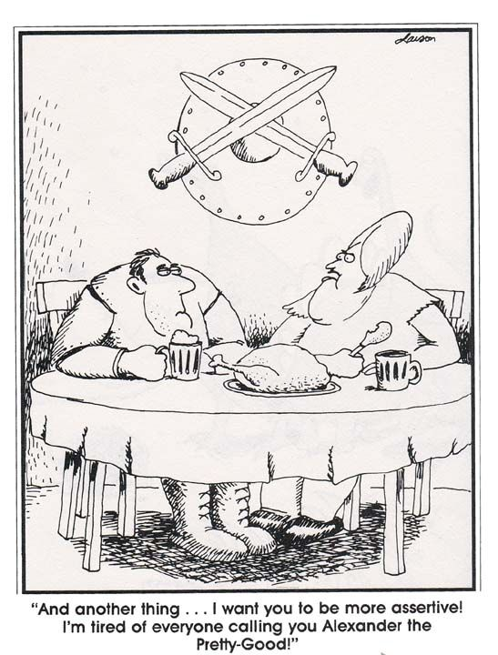
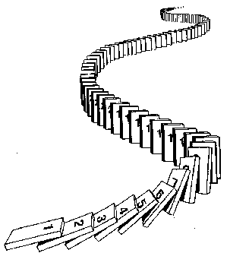
CSE 311: Foundations of Computing
Lecture 16: Induction & Strong Induction

Slide 2
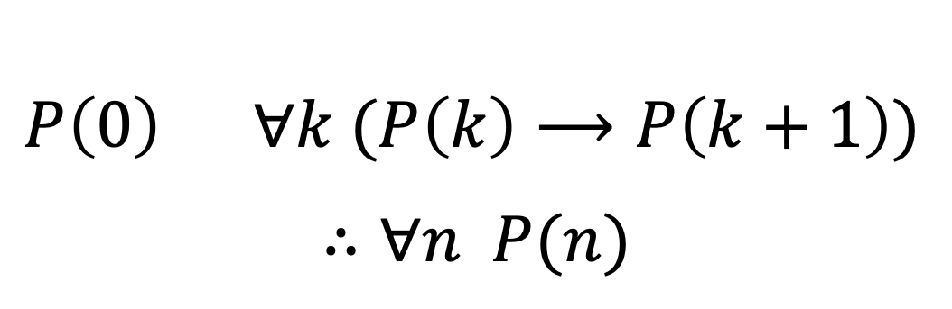
Last Time: New Inference Rule
Domain: Natural Numbers
$P\left(0\right)$ $∀k (P\left(k\right)⟶P\left(k+1\right))$
$$∴∀n P(n)$$
Formal steps
Show P(0)
Assume P(k), Prove P(k+1), Conclude P(k)→ P(k+1)
Conclude ∀ k (P(k)→ P(k+1))
Conclude ∀ n P(n)
Notes:
New way to prove “for all” claims

Slide 3
Last Time: Induction Is A Rule of Inference
Domain: Natural Numbers
$$P\left(0\right)$$
$$∀k (P\left(k\right)⟶P\left(k+1\right))$$
$$∴∀n P(n)$$
How do the givens prove P(5)?
P(0)→P(1) P(1)→P(2) P(2)→P(3) P(3)→P(4 ) P(4)→P(5)
$$P(0)$$
$$P(1)$$
$$P(2)$$
$$P(3)$$
$$P(4)$$
$$P(5)$$
First, we have P(0).
Since P(n) → P(n+1) for all n, we have P(0) → P(1).
Since P(0) is true and P(0) → P(1), by Modus Ponens, P(1) is true.
Since P(n) → P(n+1) for all n, we have P(1) → P(2).
Since P(1) is true and P(1) → P(2), by Modus Ponens, P(2) is true.
Formal steps
Show P(0)
Assume P(k), Prove P(k+1), Conclude P(k)→ P(k+1)
Conclude ∀ k (P(k)→ P(k+1))
Conclude ∀ n P(n)
Notes:
P(0) Given
P(0) -> P(1) Elim forall
P(1) MP
…

Slide 4
Last Time: Translating to an English Proof
$$P\left(0\right)$$
$$∀k (P\left(k\right)⟶P\left(k+1\right))$$
$$∴∀n P(n)$$
Base Case
1. Prove P(0)
Let k be an arbitrary integer ≥ 0
3.1. Suppose that P(k) is true
3.2. ...
3.3. Prove P(k+1) is true
P(k) → P(k+1) Direct Proof Rule
∀k (P(k) → P(k+1)) Intro ∀: 2, 3
∀n P(n) Induction: 1, 4
Inductive
Hypothesis
Inductive
Step
Conclusion

Slide 5
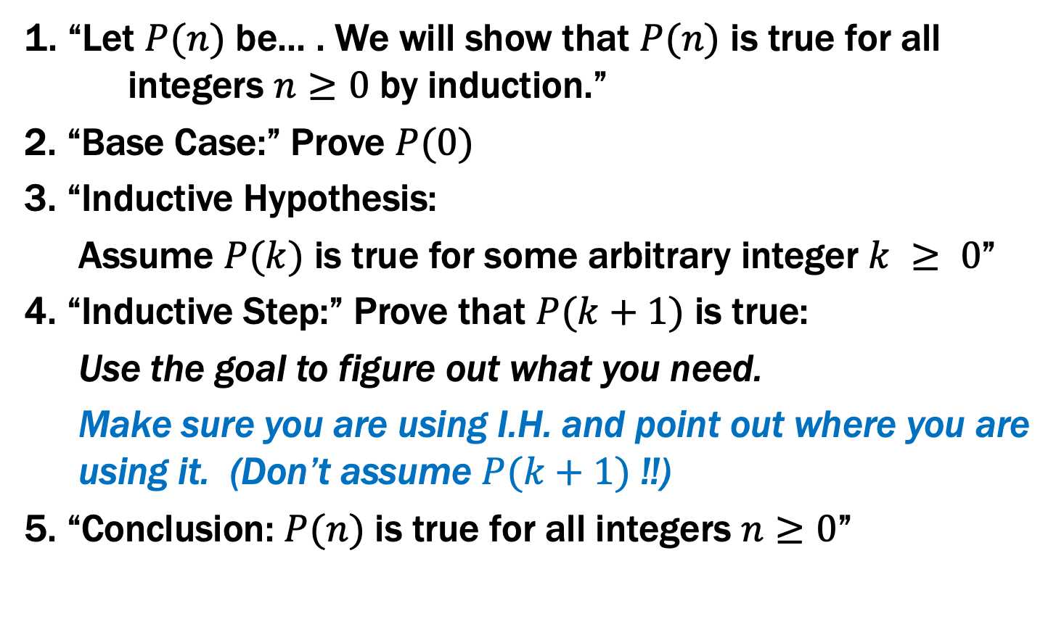
Last Time: Inductive Proofs In 5 Easy Steps
1. “Let $P(n)$ be... . We will show that $P(n)$ is true for all integers $n≥0$ by induction.”
2. “Base Case:” Prove $P(0)$
3. “Inductive Hypothesis:
Assume $P(k)$ is true for some arbitrary integer $k ≥ 0$”
4. “Inductive Step:” Prove that $P(k+1)$ is true:
Use the goal to figure out what you need.
Make sure you are using I.H. and point out where you are using it. (Don’t assume $P(k+1)$ !!)
5. “Conclusion: $P(n)$ is true for all integers $n≥0$”

Slide 6
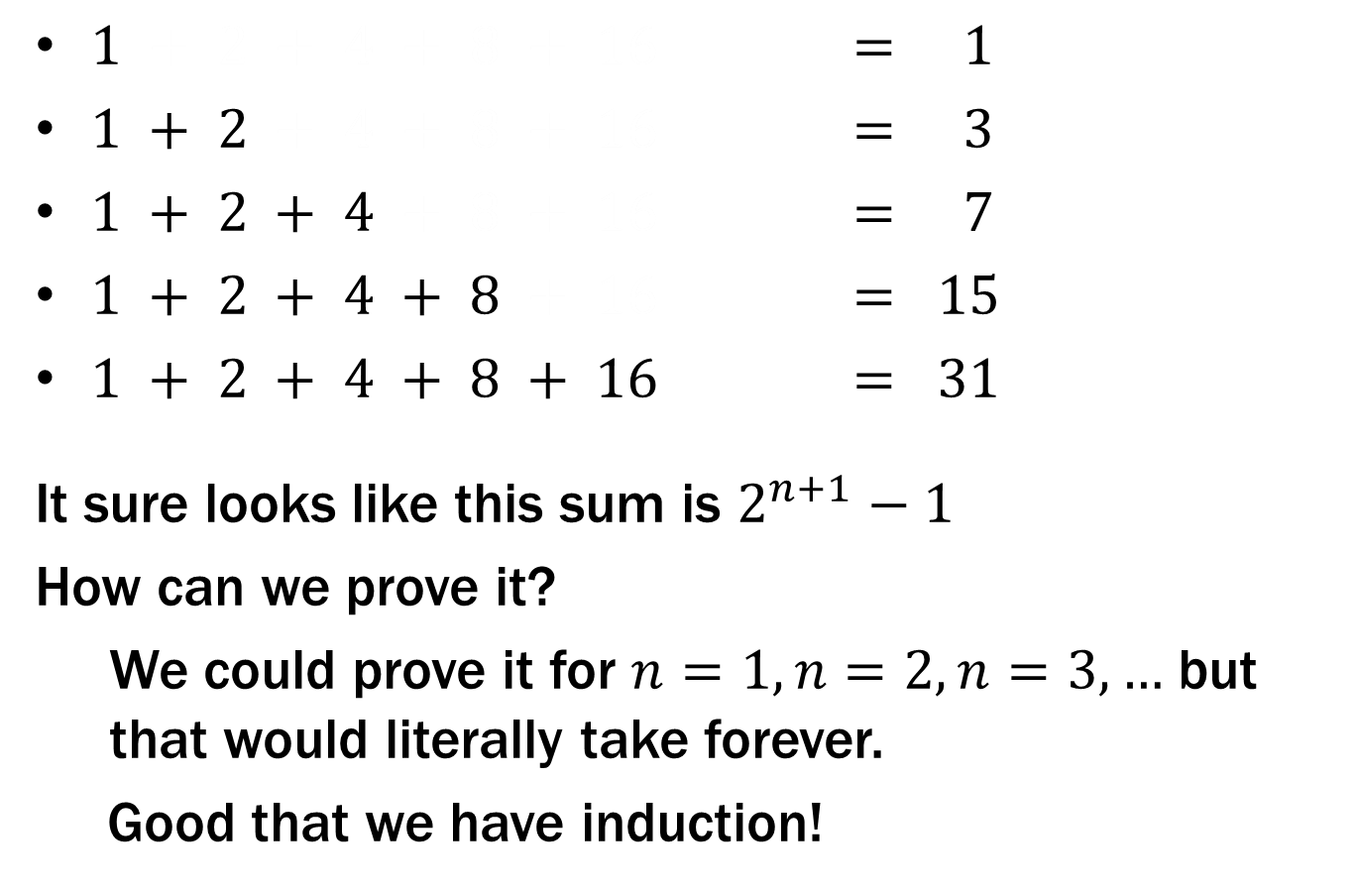
What is $1 + 2 + 4 + … + 2n$ ?
$1 + 2 + 4 + 8 + 16 = 1$
$1 + 2 + 4 + 8 + 16 = 3$
$1 + 2 + 4 + 8 + 16 = 7$
$1 + 2 + 4 + 8 + 16 = 15$
$1 + 2 + 4 + 8 + 16 = 31$
It sure looks like this sum is $2^{n+1}−1$
How can we prove it?
We could prove it for $n=1, n=2, n=3,…$ but that would literally take forever.
Good that we have induction!

Slide 7
Prove $1 + 2 + 4 + … + 2n =2^{n+1}– 1$

Slide 8
Prove $1 + 2 + 4 + … + 2n =2^{n+1}– 1$
Let P(n) be “2⁰ + 2¹ + … + 2^{n} = 2^{n+1} – 1”. We will show P(n) is true for all natural numbers by induction.
Base Case (n=0): 2⁰ = 1 = 2 – 1 = 2⁰⁺¹ – 1
Induction Hypothesis: Suppose that P(k) is true for some arbitrary integer k ≥ 0.
Induction Step:
Goal: Show P(k+1), i.e. show 1 + 2 + … + 2^{k} + 2^{k+1} = 2^{k+2} – 1
1 + 2 + … + 2^{k} = 2^{k+1} – 1 by IH
Adding 2^{k+1} to both sides, we get:
1 + 2 + … + 2^{k} + 2^{k+1} = 2^{k+1} + 2^{k+1} – 1
Note that 2^{k+1} + 2^{k+1} = 2(2^{k+1}) = 2^{k+2}.
So, we have 1 + 2 + … + 2^{k} + 2^{k+1} = 2^{k+2} – 1, which is
exactly P(k+1).
5. Thus P(k) is true for all k ∈ℕ, by induction.
Examples to show its true
P(0)
P(k) → P(k+1)

Slide 9
Prove $1 + 2 + 4 + … + 2n =2^{n+1}– 1$
Let P(n) be “2⁰ + 2¹ + … + 2^{n} = 2^{n+1} – 1”. We will show P(n) is true for all natural numbers by induction.
Base Case (n=0): 2⁰ = 1 = 2 – 1 = 2⁰⁺¹ – 1 so P(0) is true.
Induction Hypothesis: Suppose that P(k) is true for some arbitrary integer k ≥ 0.
Induction Step:
Goal: Show P(k+1), i.e. show 1 + 2 + … + 2^{k} + 2^{k+1} = 2^{k+2} – 1
1 + 2 + … + 2^{k} = 2^{k+1} – 1 by IH
Adding 2^{k+1} to both sides, we get:
1 + 2 + … + 2^{k} + 2^{k+1} = 2^{k+1} + 2^{k+1} – 1
Note that 2^{k+1} + 2^{k+1} = 2(2^{k+1}) = 2^{k+2}.
So, we have 1 + 2 + … + 2^{k} + 2^{k+1} = 2^{k+2} – 1, which is
exactly P(k+1).
5. Thus P(k) is true for all k ∈ℕ, by induction.
Examples to show its true
P(0)
P(k) → P(k+1)

Slide 10
Prove $1 + 2 + 4 + … + 2n =2^{n+1}– 1$
Let P(n) be “2⁰ + 2¹ + … + 2^{n} = 2^{n+1} – 1”. We will show P(n) is true for all natural numbers by induction.
Base Case (n=0): 2⁰ = 1 = 2 – 1 = 2⁰⁺¹ – 1 so P(0) is true.
Induction Hypothesis: Suppose that P(k) is true for some arbitrary integer k ≥ 0, i.e., that 2⁰ + 2¹ + … + 2^{k} = 2^{k+1} – 1.
Goal: Show P(k+1I.e.,), i.e. show 1 + 2 + … + 2^{k} + 2^{k+1} = 2^{k+2} – 1
1 + 2 + … + 2^{k} = 2^{k+1} – 1 by IH
Adding 2^{k+1} to both sides, we get:
1 + 2 + … + 2^{k} + 2^{k+1} = 2^{k+1} + 2^{k+1} – 1
Note that 2^{k+1} + 2^{k+1} = 2(2^{k+1}) = 2^{k+2}.
So, we have 1 + 2 + … + 2^{k} + 2^{k+1} = 2^{k+2} – 1, which is
exactly P(k+1).
5. Thus P(k) is true for all k ∈ℕ, by induction.
Examples to show its true
P(0)
P(k) → P(k+1)

Slide 11
Prove $1 + 2 + 4 + … + 2n =2^{n+1}– 1$
Let P(n) be “2⁰ + 2¹ + … + 2^{n} = 2^{n+1} – 1”. We will show P(n) is true for all natural numbers by induction.
Base Case (n=0): 2⁰ = 1 = 2 – 1 = 2⁰⁺¹ – 1 so P(0) is true.
Induction Hypothesis: Suppose that P(k) is true for some arbitrary integer k ≥ 0, i.e., that 2⁰ + 2¹ + … + 2^{k} = 2^{k+1} – 1.
Induction Step:
Goal: Show P(k+1), i.e. show 2⁰ + 2¹ + … + 2^{k} + 2^{k+1} = 2^{k+2} – 1
1 + 2 + … + 2^{k} = 2^{k+1} – 1 by IH
Adding 2^{k+1} to both sides, we get:
1 + 2 + … + 2^{k} + 2^{k+1} = 2^{k+1} + 2^{k+1} – 1
Note that 2^{k+1} + 2^{k+1} = 2(2^{k+1}) = 2^{k+2}.
So, we have 1 + 2 + … + 2^{k} + 2^{k+1} = 2^{k+2} – 1, which is
exactly P(k+1).
5. Thus P(k) is true for all k ∈ℕ, by induction.
Examples to show its true
P(0)
P(k) → P(k+1)

Slide 12
Prove $1 + 2 + 4 + … + 2n =2^{n+1}– 1$
Let P(n) be “2⁰ + 2¹ + … + 2^{n} = 2^{n+1} – 1”. We will show P(n) is true for all natural numbers by induction.
Base Case (n=0): 2⁰ = 1 = 2 – 1 = 2⁰⁺¹ – 1 so P(0) is true.
Induction Hypothesis: Suppose that P(k) is true for some arbitrary integer k ≥ 0, i.e., that 2⁰ + 2¹ + … + 2^{k} = 2^{k+1} – 1.
Induction Step:
2⁰ + 2¹ + … + 2^{k} = 2^{k+1} – 1 by IH
Adding 2^{k+1} to both sides, we get:
2⁰ + 2¹ + … + 2^{k} + 2^{k+1} = 2^{k+1} + 2^{k+1} – 1
Note that 2^{k+1} + 2^{k+1} = 2(2^{k+1}) = 2^{k+2}.
So, we have 2⁰ + 2¹ + … + 2^{k} + 2^{k+1} = 2^{k+2} – 1, which is
exactly P(k+1).
5. Thus P(k) is true for all k ∈ℕ, by induction.
Examples to show its true
P(0)
P(k) → P(k+1)

Slide 13
Prove $1 + 2 + 4 + … + 2n =2^{n+1}– 1$
Let P(n) be “2⁰ + 2¹ + … + 2^{n} = 2^{n+1} – 1”. We will show P(n) is true for all natural numbers by induction.
Base Case (n=0): 2⁰ = 1 = 2 – 1 = 2⁰⁺¹ – 1 so P(0) is true.
Induction Hypothesis: Suppose that P(k) is true for some arbitrary integer k ≥ 0, i.e., that 2⁰ + 2¹ + … + 2^{k} = 2^{k+1} – 1.
Induction Step:
We can calculate
2⁰ + 2¹ + … + 2^{k} + 2^{k+1} = (2⁰+2¹+ … + 2^{k}) + 2^{k+1}
= (2^{k+1} – 1) + 2^{k+1} by the IH
= 2(2^{k+1}) – 1
= 2^{k+2} – 1,
which is exactly P(k+1).
5. Thus P(k) is true for all k ∈ℕ, by induction.
Examples to show its true
P(0)
P(k) → P(k+1)
Alternative way of writing the inductive step

Slide 14
Prove $1 + 2 + 4 + … + 2n =2^{n+1}– 1$
Let P(n) be “2⁰ + 2¹ + … + 2^{n} = 2^{n+1} – 1”. We will show P(n) is true for all natural numbers by induction.
Base Case (n=0): 2⁰ = 1 = 2 – 1 = 2⁰⁺¹ – 1 so P(0) is true.
Induction Hypothesis: Suppose that P(k) is true for some arbitrary integer k ≥ 0, i.e., that 2⁰ + 2¹ + … + 2^{k} = 2^{k+1} – 1.
Induction Step:
We can calculate
2⁰ + 2¹ + … + 2^{k} + 2^{k+1} = (2⁰+2¹+ … + 2^{k}) + 2^{k+1}
= (2^{k+1} – 1) + 2^{k+1} by the IH
= 2(2^{k+1}) – 1
= 2^{k+2} – 1,
which is exactly P(k+1).
5. Thus P(n) is true for all n ∈ℕ, by induction.
Examples to show its true
P(0)
P(k) → P(k+1)

Slide 15
Prove$1 + 2 + 3 + … + n = n(n+1)/2$

Slide 16
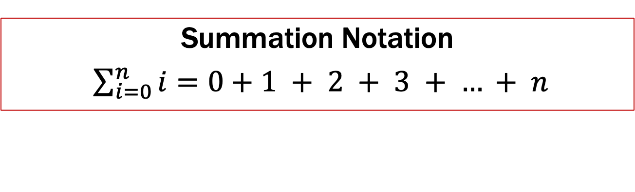
Prove$1 + 2 + 3 + … + n = n(n+1)/2$
Let P(n) be “0 + 1 + 2 + … + n = n(n+1)/2”. We will show P(n) is true for all natural numbers by induction.
Base Case (n=0): 0 = 0(0+1)/2. Therefore P(0) is true.
Induction Hypothesis: Suppose that P(k) is true for some arbitrary integer k ≥ 0.
Induction Step:
Goal: Show P(k+1), i.e. show 1 + 2 + … + (n+1) = (n+1)(n+2)/2
1 + 2 + … + n = n(n+1)/2 by IH
Adding n+1 to both sides, we get:
1 + 2 + … + n + (n+1) = n(n+1)/2 + (n+1)
Now n(n+1)/2 + (n+1) = (n+1)(n/2 + 1) = (n+1)(n+2)/2.
So, we have 1 + 2 + … + n + (n+1) = (n+1)(n+2)/2, which is
exactly P(k+1).
5. Thus P(k) is true for all k ∈ℕ, by induction.
Summation Notation
$\sum_{i=0}^{n}{i}=0+1 + 2 + 3 + … + n$
Examples to show its true
P(0)
P(k) → P(k+1)

Slide 17
Prove$1 + 2 + 3 + … + n = n(n+1)/2$
Let P(n) be “0 + 1 + 2 + … + n = n(n+1)/2”. We will show P(n) is true for all natural numbers by induction.
Base Case (n=0): 0 = 0(0+1)/2. Therefore P(0) is true.
Induction Hypothesis: Suppose that P(k) is true for some arbitrary integer k ≥ 0.
Induction Step:
Goal: Show P(k+1), i.e. show 1 + 2 + … + (n+1) = (n+1)(n+2)/2
1 + 2 + … + n = n(n+1)/2 by IH
Adding n+1 to both sides, we get:
1 + 2 + … + n + (n+1) = n(n+1)/2 + (n+1)
Now n(n+1)/2 + (n+1) = (n+1)(n/2 + 1) = (n+1)(n+2)/2.
So, we have 1 + 2 + … + n + (n+1) = (n+1)(n+2)/2, which is
exactly P(k+1).
5. Thus P(k) is true for all k ∈ℕ, by induction.
Summation Notation
$\sum_{i=0}^{n}{i}=0+1 + 2 + 3 + … + n$
Examples to show its true
P(0)
P(k) → P(k+1)

Slide 18
Prove$1 + 2 + 3 + … + n = n(n+1)/2$
Let P(n) be “0 + 1 + 2 + … + n = n(n+1)/2”. We will show P(n) is true for all natural numbers by induction.
Base Case (n=0): 0 = 0(0+1)/2. Therefore P(0) is true.
Induction Hypothesis: Suppose that P(k) is true for some arbitrary integer k ≥ 0. I.e., suppose 1 + 2 + …+ k = k(k+1)/2
1 + 2 + … + n n(n+1)/2 by IH
Adding n+1 to both sides, we get:
1 + 2 + … + n + (n+1) = n(n+1)/2 + (n+1)
Now n(n+1)/2 + (n+1) = (n+1)(n/2 + 1) = (n+1)(n+2)/2.
So, we have 1 + 2 + … + n + (n+1) = (n+1)(n+2)/2, which is
exactly P(k+1).
5. Thus P(k) is true for all k ∈ℕ, by induction.
“some” or “an”
not any!
Examples to show its true
P(0)
P(k) → P(k+1)

Slide 19
Prove$1 + 2 + 3 + … + n = n(n+1)/2$
Let P(n) be “0 + 1 + 2 + … + n = n(n+1)/2”. We will show P(n) is true for all natural numbers by induction.
Base Case (n=0): 0 = 0(0+1)/2. Therefore P(0) is true.
Induction Hypothesis: Suppose that P(k) is true for some arbitrary integer k ≥ 0. I.e., suppose 1 + 2 + …+ k = k(k+1)/2
Induction Step:
Goal: Show P(k+1), i.e. show 1 + 2 + …+ k+ (k+1) = (k+1)(k+2)/2
1 + 2 + … + n = n(n+1)/2 by IH
Adding n+1 to both sides, we get:
1 + 2 + … + n + (n+1) = n(n+1)/2 + (n+1)
Now n(n+1)/2 + (n+1) = (n+1)(n/2 + 1) = (n+1)(n+2)/2.
So, we have 1 + 2 + … + n + (n+1) = (n+1)(n+2)/2, which is
exactly P(k+1).
5. Thus P(k) is true for all k ∈ℕ, by induction.
Examples to show its true
P(0)
P(k) → P(k+1)

Slide 20
Prove$1 + 2 + 3 + … + n = n(n+1)/2$
Let P(n) be “0 + 1 + 2 + … + n = n(n+1)/2”. We will show P(n) is true for all natural numbers by induction.
Base Case (n=0): 0 = 0(0+1)/2. Therefore P(0) is true.
Induction Hypothesis: Suppose that P(k) is true for some arbitrary integer k ≥ 0. I.e., suppose 1 + 2 + …+ k = k(k+1)/2
Induction Step:
1 + 2 + … + k + (k+1) = (1 + 2 + … + k) + (k+1)
= k(k+1)/2 + (k+1) by IH
= (k+1)(k/2 + 1)
= (k+1)(k+2)/2
So, we have shown 1 + 2 + … + k + (k+1) = (k+1)(k+2)/2,
which is exactly P(k+1).
5. Thus P(n) is true for all n ∈ℕ, by induction.
Examples to show its true
P(0)
P(k) → P(k+1)

Slide 21
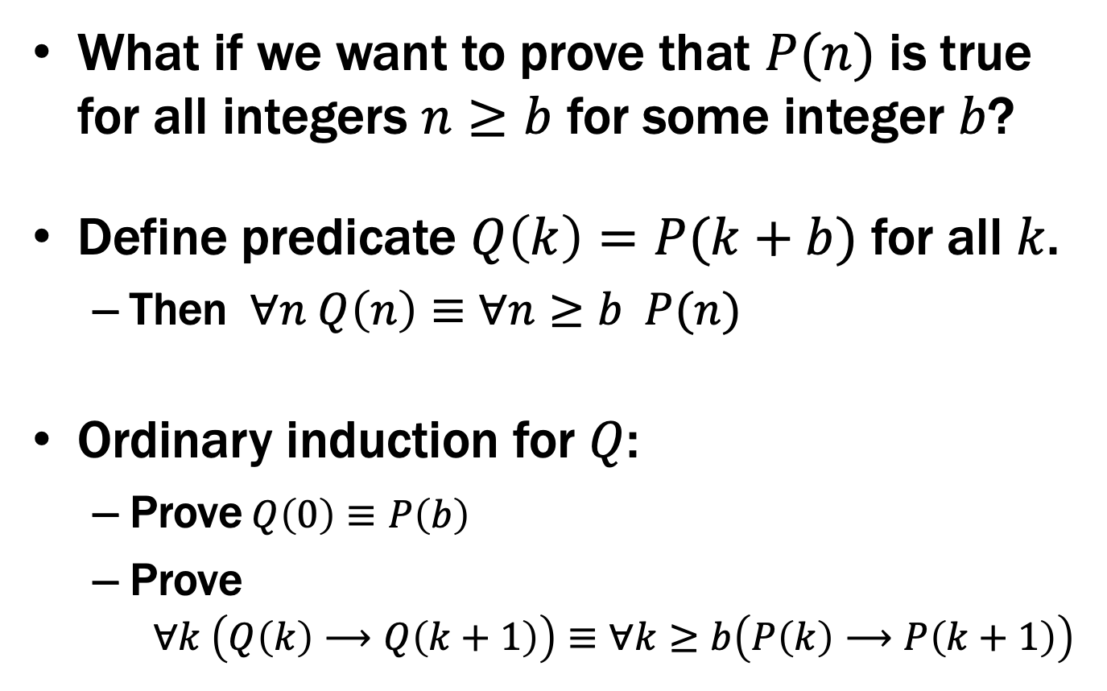
Induction: Changing the start line
What if we want to prove that $P(n)$ is true for all integers $n≥b$ for some integer $b$?
Define predicate $Q\left(k\right)=P(k+b)$ for all $k$.
Then $∀n Q\left(n\right)≡∀n≥b P(n)$
Ordinary induction for $Q$:
Prove$Q\left(0\right)≡P\left(b\right)$
Prove $∀k \left(Q\left(k\right)⟶Q\left(k+1\right)\right)≡∀k≥b\left(P\left(k\right)⟶P\left(k+1\right)\right)$

Slide 22
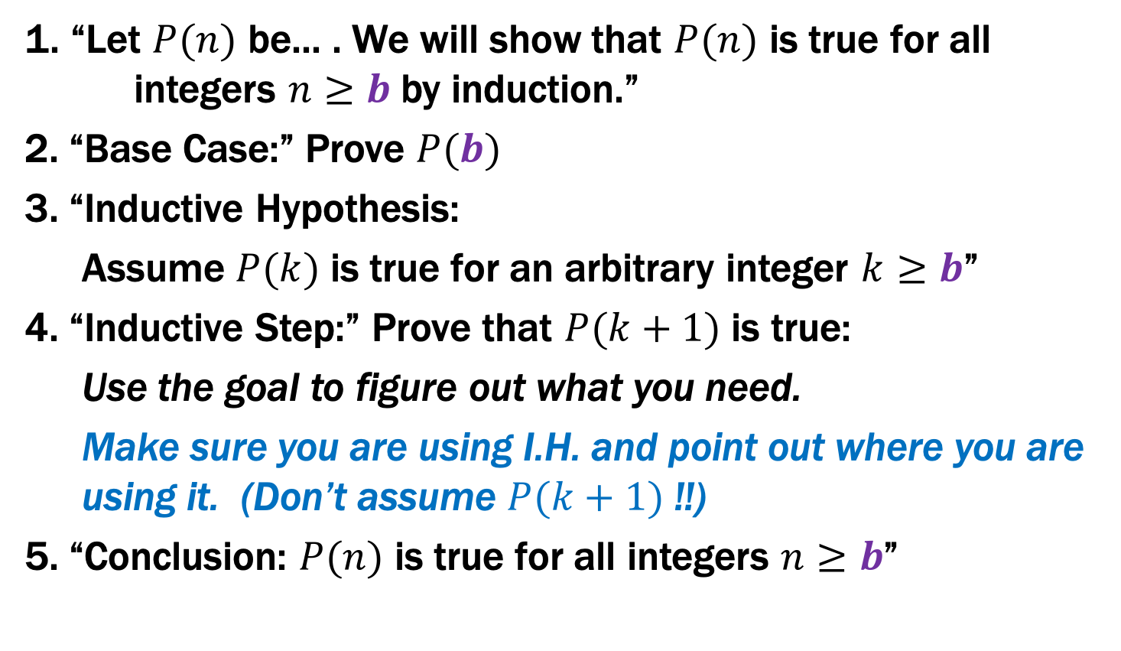
Inductive Proofs In 5 Easy Steps
1. “Let $P(n)$ be... . We will show that $P(n)$ is true for all integers $n≥b$ by induction.”
2. “Base Case:” Prove $P(b)$
3. “Inductive Hypothesis:
Assume $P(k)$ is true for an arbitrary integer $k≥b$”
4. “Inductive Step:” Prove that $P(k+1)$ is true:
Use the goal to figure out what you need.
Make sure you are using I.H. and point out where you are using it. (Don’t assume $P(k+1)$ !!)
5. “Conclusion: $P(n)$ is true for all integers $n≥b$”

Slide 23

Prove $3n≥n^{2}+3$ for all $n≥2$
Examples to show its true
P(0)
P(k) → P(k+1)

Slide 24
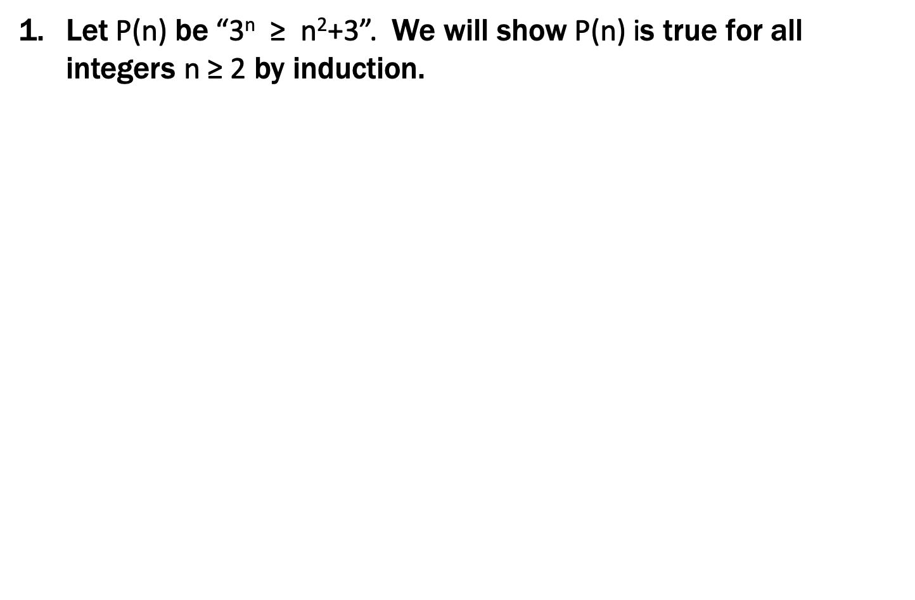
Prove $3n≥n^{2}+3$ for all $n≥2$
Let P(n) be “3^{n} ≥ n²+3”. We will show P(n) is true for all integers n ≥ 2 by induction.
Base Case (n=2): 3² = 9 $≥$7 = 4+3 = 2²+3 so P(2) is true.
Hypothesis: Suppose that P(k) is true for some arbitrary integer k ≥ 2.
Induction Step:
Goal: Show P(k+1), i.e. show 3^{k+1} ≥ (k+1)²+3=k²+2k+4
3^{k+1} = 3(3^{k})
≥ 3(k²+3) by the IH
= k²+2k²+9
≥ k²+2k+1 = (k+1)² since k ≥ 1.
Therefore P(k+1) is true.
5. Thus P(n) is true for all n ∈ℕ, by induction.
Examples to show its true
P(0)
P(k) → P(k+1)

Slide 25
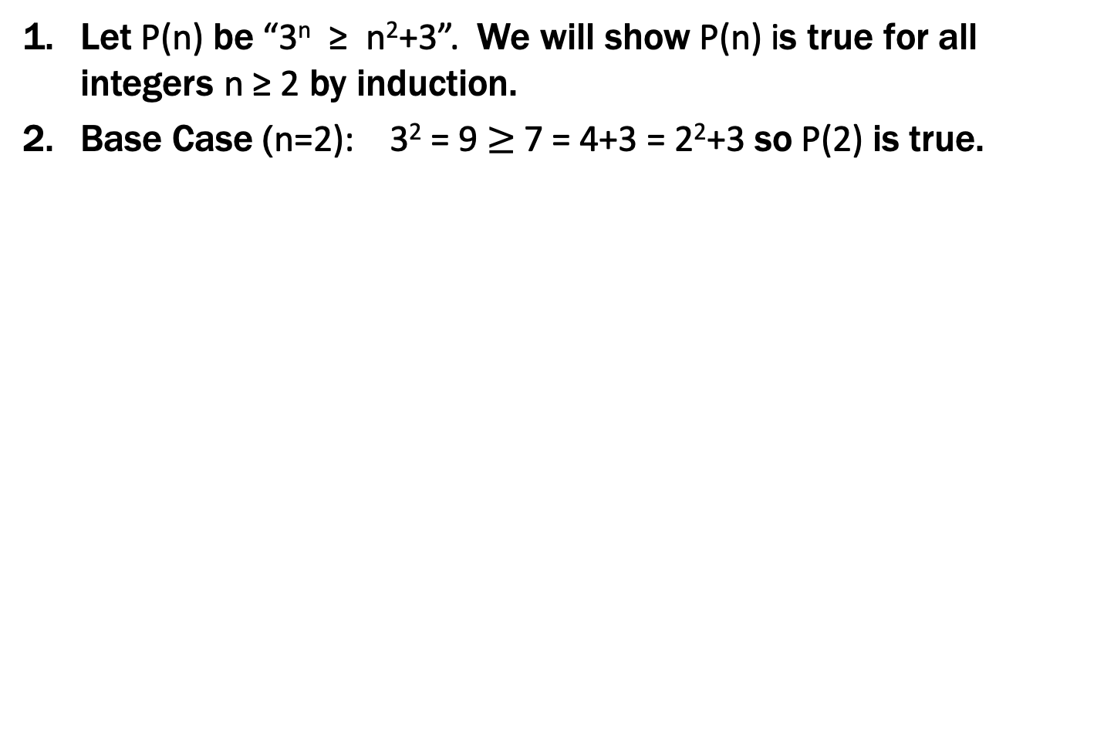
Prove $3n≥n^{2}+3$ for all $n≥2$
Let P(n) be “3^{n} ≥ n²+3”. We will show P(n) is true for all integers n ≥ 2 by induction.
Base Case (n=2): 3² = 9 $≥$7 = 4+3 = 2²+3 so P(2) is true.
Inductive Hypothesis: Suppose that P(k) is true for some arbitrary integer k ≥ 2.
Inductive Step:
Goal: Show P(k+1), i.e. show 3^{k+1} ≥ (k+1)²+3=k²+2k+4
3^{k+1} = 3(3^{k})
≥ 3(k²+3) by the IH
= k²+2k²+9
≥ k²+2k+1 = (k+1)² since k ≥ 1.
Therefore P(k+1) is true.
5. Thus P(n) is true for all n ∈ℕ, by induction.
Examples to show its true
P(0)
P(k) → P(k+1)

Slide 26
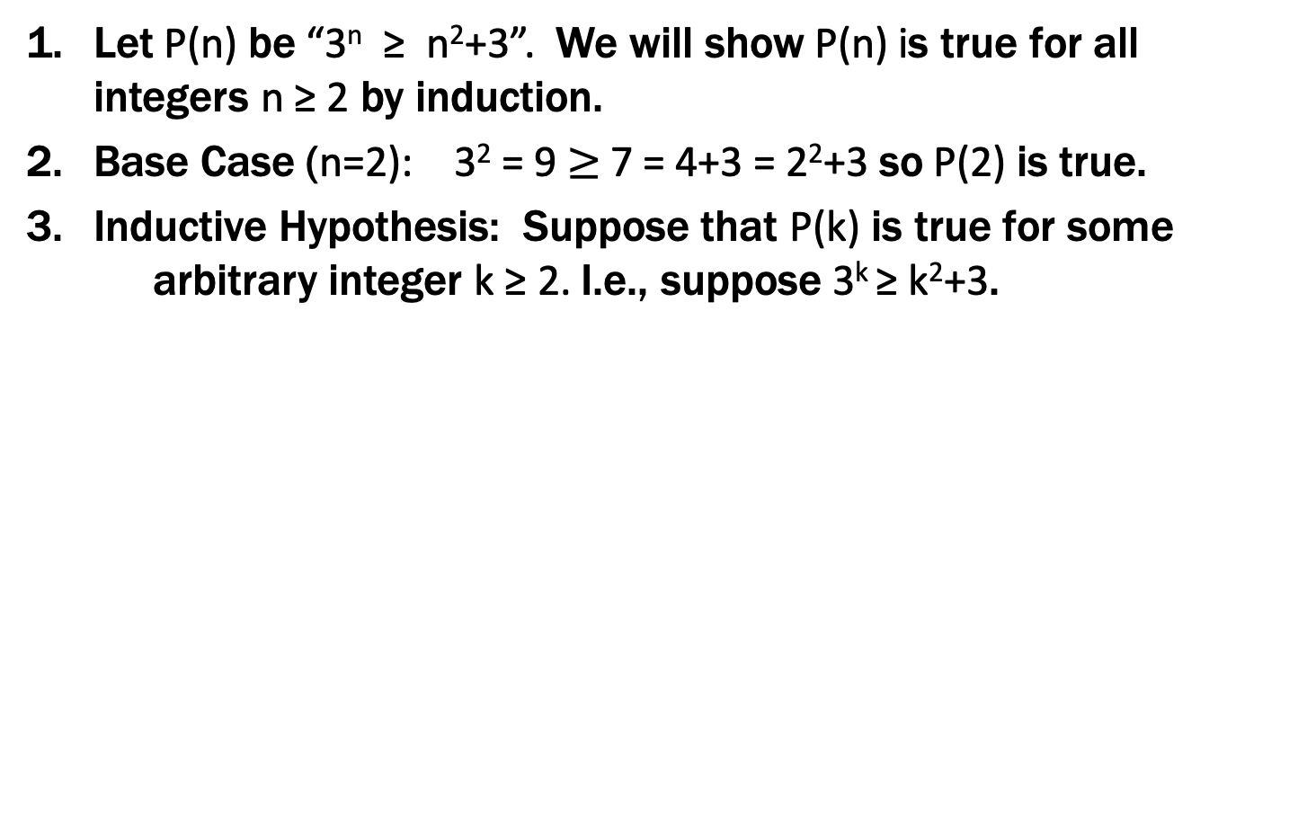
Prove $3n≥n^{2}+3$ for all $n≥2$
Let P(n) be “3^{n} ≥ n²+3”. We will show P(n) is true for all integers n ≥ 2 by induction.
Base Case (n=2): 3² = 9 $≥$7 = 4+3 = 2²+3 so P(2) is true.
Inductive Hypothesis: Suppose that P(k) is true for some arbitrary integer k ≥ 2. I.e., suppose 3^{k} ≥ k²+3.
=k²+2k+4
3^{k+1} = 3(3^{k})
≥ 3(k²+3) by the IH
= k²+2k²+9
≥ k²+2k+1 = (k+1)² since k ≥ 1.
Therefore P(k+1) is true.
5. Thus P(n) is true for all n ∈ℕ, by induction.
Examples to show its true
P(0)
P(k) → P(k+1)

Slide 27
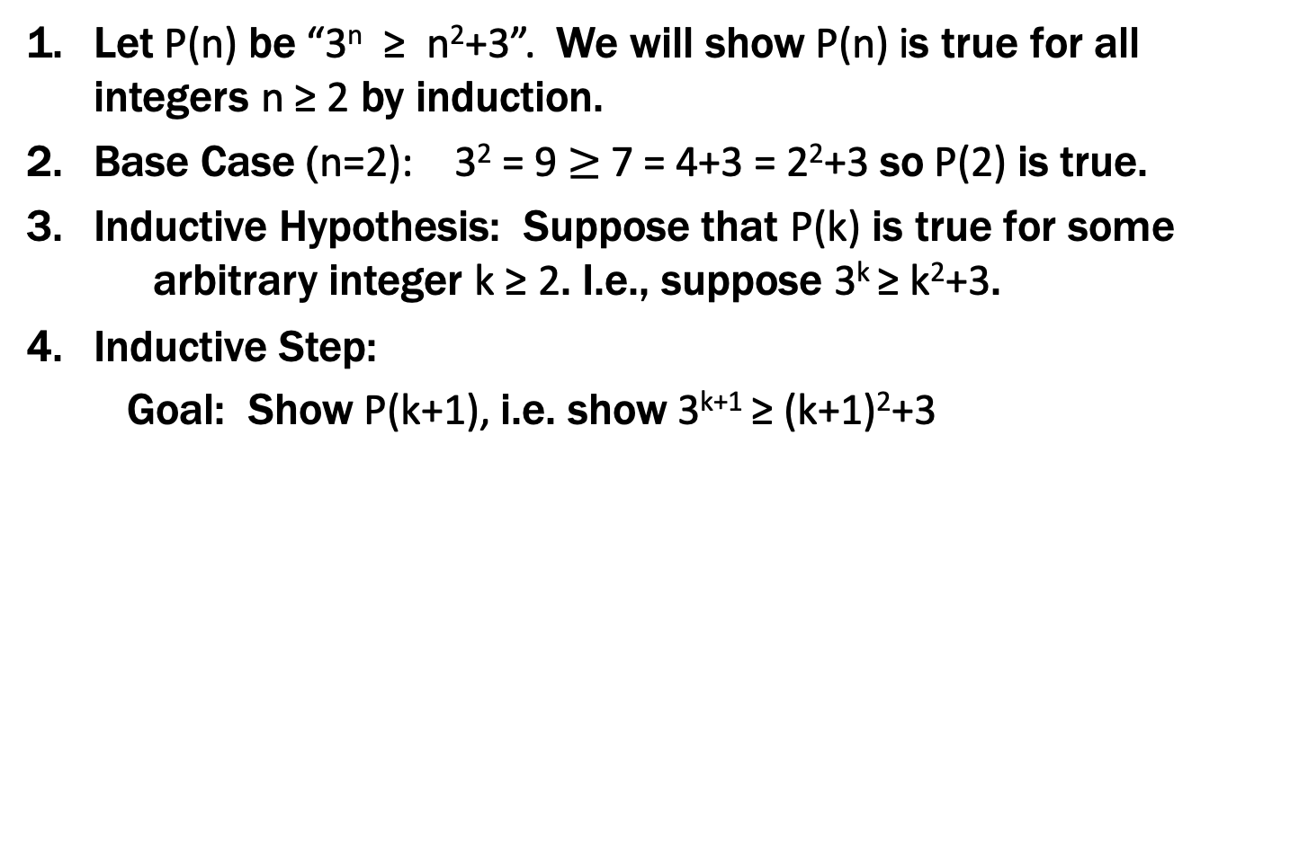
Prove $3n≥n^{2}+3$ for all $n≥2$
Let P(n) be “3^{n} ≥ n²+3”. We will show P(n) is true for all integers n ≥ 2 by induction.
Base Case (n=2): 3² = 9 $≥$7 = 4+3 = 2²+3 so P(2) is true.
Inductive Hypothesis: Suppose that P(k) is true for some arbitrary integer k ≥ 2. I.e., suppose 3^{k} ≥ k²+3.
Inductive Step:
Goal: Show P(k+1), i.e. show 3^{k+1} ≥ (k+1)²+3=k²+2k+4
3^{k+1} = 3(3^{k})
≥ 3(k²+3) by the IH
= k²+2k²+9
≥ k²+2k+1 = (k+1)² since k ≥ 1.
Therefore P(k+1) is true.
5. Thus P(n) is true for all n ∈ℕ, by induction.
Examples to show its true
P(0)
P(k) → P(k+1)

Slide 28
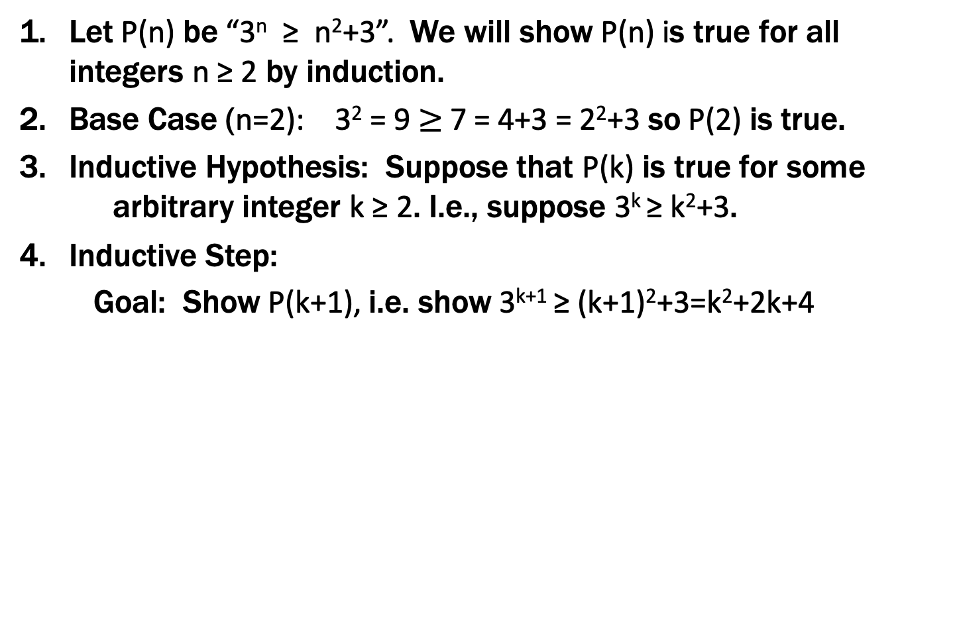
Prove $3n≥n^{2}+3$ for all $n≥2$
Let P(n) be “3^{n} ≥ n²+3”. We will show P(n) is true for all integers n ≥ 2 by induction.
Base Case (n=2): 3² = 9 $≥$7 = 4+3 = 2²+3 so P(2) is true.
Inductive Hypothesis: Suppose that P(k) is true for some arbitrary integer k ≥ 2. I.e., suppose 3^{k} ≥ k²+3.
Inductive Step:
Goal: Show P(k+1), i.e. show 3^{k+1} ≥ (k+1)²+3=k²+2k+4
3^{k+1} = 3(3^{k})
≥ 3(k²+3) by the IH
= k²+2k²+9
≥ k²+2k+1 = (k+1)² since k ≥ 1.
Therefore P(k+1) is true.
5. Thus P(n) is true for all n ∈ℕ, by induction.
Examples to show its true
P(0)
P(k) → P(k+1)

Slide 29
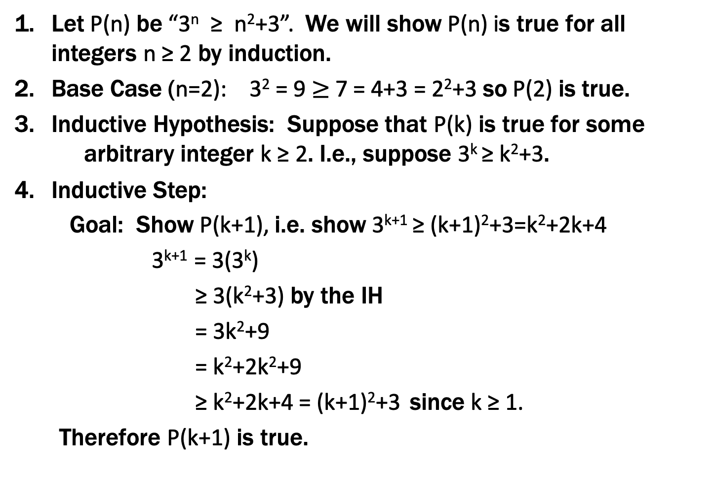
Prove $3n≥n^{2}+3$ for all $n≥2$
Let P(n) be “3^{n} ≥ n²+3”. We will show P(n) is true for all integers n ≥ 2 by induction.
Base Case (n=2): 3² = 9 $≥$7 = 4+3 = 2²+3 so P(2) is true.
Inductive Hypothesis: Suppose that P(k) is true for some arbitrary integer k ≥ 2. I.e., suppose 3^{k} ≥ k²+3.
Inductive Step:
Goal: Show P(k+1), i.e. show 3^{k+1} ≥ (k+1)²+3=k²+2k+4
3^{k+1} = 3(3^{k})
≥ 3(k²+3) by the IH
= 3k²+9
= k²+2k²+9
≥ k²+2k+4 = (k+1)²+3 since k ≥ 1.
Therefore P(k+1) is true.
5. Thus P(n) is true for all integers n ≥ 2, by induction.
Examples to show its true
P(0)
P(k) → P(k+1)

Slide 30
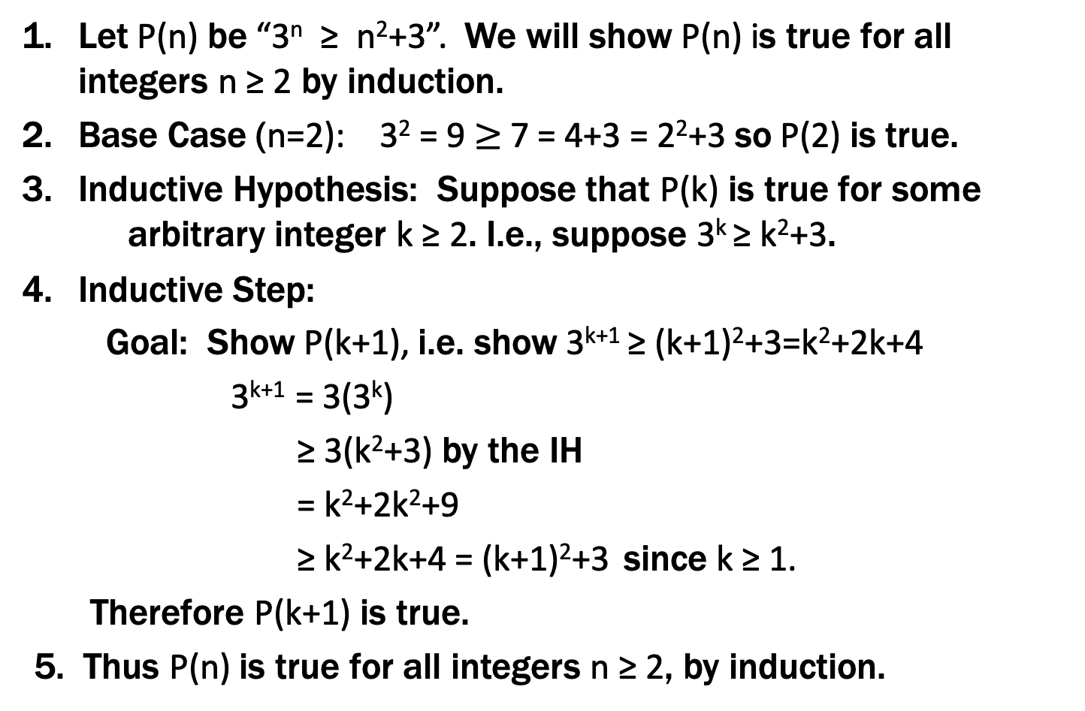
Prove $3n≥n^{2}+3$ for all $n≥2$
Let P(n) be “3^{n} ≥ n²+3”. We will show P(n) is true for all integers n ≥ 2 by induction.
Base Case (n=2): 3² = 9 $≥$7 = 4+3 = 2²+3 so P(2) is true.
Inductive Hypothesis: Suppose that P(k) is true for some arbitrary integer k ≥ 2. I.e., suppose 3^{k} ≥ k²+3.
Inductive Step:
Goal: Show P(k+1), i.e. show 3^{k+1} ≥ (k+1)²+3=k²+2k+4
3^{k+1} = 3(3^{k})
≥ 3(k²+3) by the IH
= k²+2k²+9
≥ k²+2k+4 = (k+1)²+3 since k ≥ 1.
Therefore P(k+1) is true.
5. Thus P(n) is true for all integers n ≥ 2, by induction.
Examples to show its true
P(0)
P(k) → P(k+1)

Slide 31
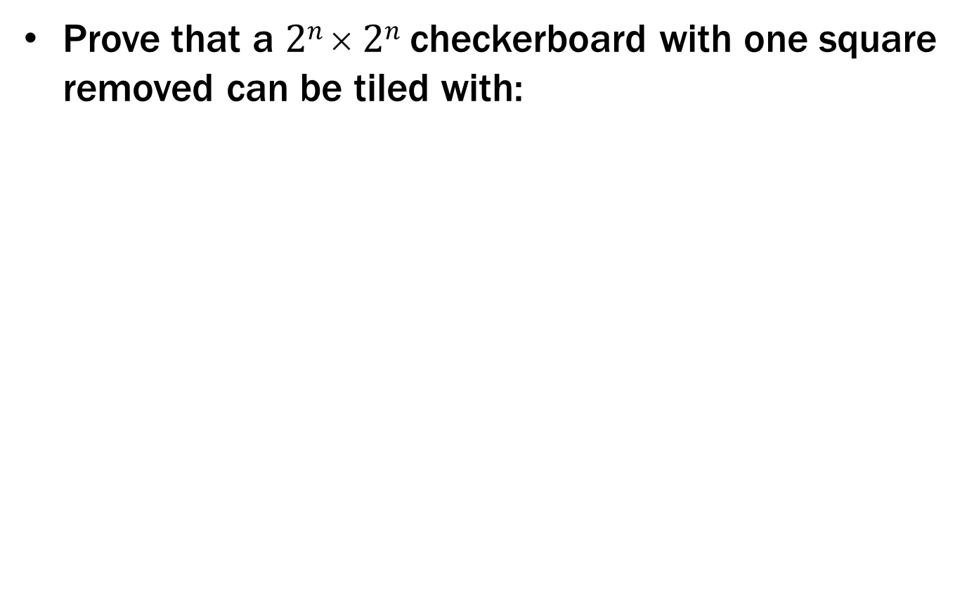
Checkerboard Tiling
Prove that a $2n  2n$checkerboard with one square removed can be tiled with:

Slide 32
Checkerboard Tiling
Let P(n) be any 2^{n} × 2^{n} checkerboard with one square removed can be tiled with . We prove P(n) for all n ≥ 1 by induction on n.

Slide 33
Checkerboard Tiling
Let P(n) be any 2^{n} × 2^{n} checkerboard with one square removed can be tiled with . We prove P(n) for all n ≥ 1 by induction on n.
Base Case: n=1

Slide 34
Checkerboard Tiling
Let P(n) be any 2^{n} × 2^{n} checkerboard with one square removed can be tiled with . We prove P(n) for all n ≥ 1 by induction on n.
Base Case: n=1
Inductive Hypothesis: Assume P(k) for some arbitrary integer k≥1

Slide 35
Checkerboard Tiling
Let P(n) be any 2^{n} × 2^{n} checkerboard with one square removed can be tiled with . We prove P(n) for all n ≥ 1 by induction on n.
Base Case: n=1
Inductive Hypothesis: Assume P(k) for some arbitrary integer k≥1
Inductive Step: Prove P(k+1)
Apply IH to each quadrant then fill with extra tile.

Slide 36
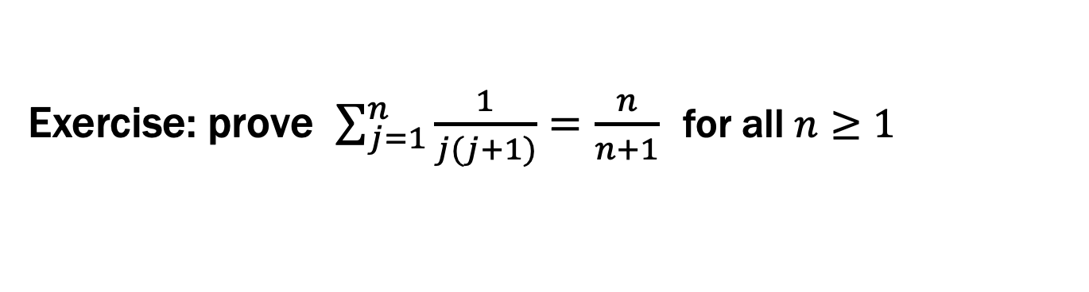
Exercise: prove $\sum_{j=1}^{n}{\frac{1}{j(j+1)}}=\frac{n}{n+1}$ for all $n≥1$
Examples to show its true
P(0)
P(k) → P(k+1)

Slide 37
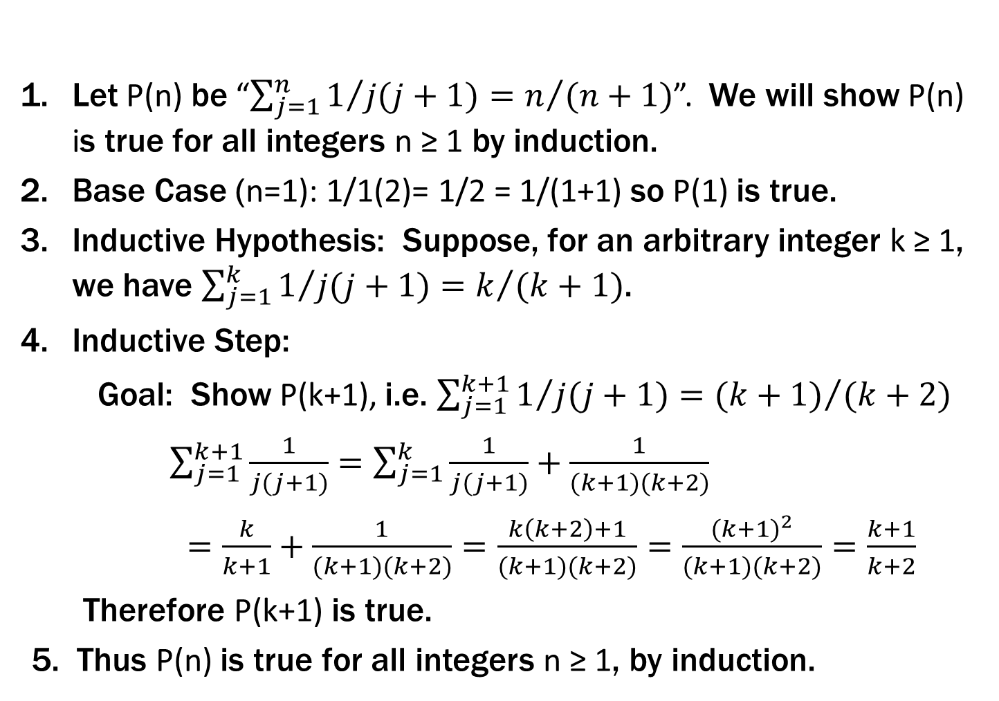
Exercise: prove $\sum_{j=1}^{n}{\frac{1}{j(j+1)}}=\frac{n}{n+1}$ for all $n≥1$
Let P(n) be “$\sum_{j=1}^{n}{1/{j(j+1)}}=n/{(n+1)}$”. We will show P(n) is true for all integers n ≥ 1 by induction.
Base Case (n=1): 1/1(2)= 1/2 = 1/(1+1) so P(1) is true.
Inductive Hypothesis: Suppose, for an arbitrary integer k ≥ 1, we have $\sum_{j=1}^{k}{1/{j(j+1)}}=k/{(k+1)}$.
Inductive Step:
Goal: Show P(k+1), i.e. $\sum_{j=1}^{k+1}{1/{j(j+1)}}={(k+1)}/{(k+2)}$
$\sum_{j=1}^{k+1}{\frac{1}{j(j+1)}}=\sum_{j=1}^{k}{\frac{1}{j(j+1)}+\frac{1}{(k+1)(k+2)}}$
$=\frac{k}{k+1}+\frac{1}{(k+1)(k+2)}=\frac{k\left(k+2\right)+1}{(k+1)(k+2)}=\frac{{(k+1)}^{2}}{(k+1)(k+2)}=\frac{k+1}{k+2}$
Therefore P(k+1) is true.
5. Thus P(n) is true for all integers n ≥ 1, by induction.
Examples to show its true
P(0)
P(k) → P(k+1)

Slide 38
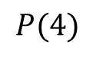
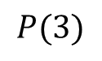
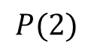
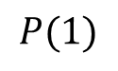
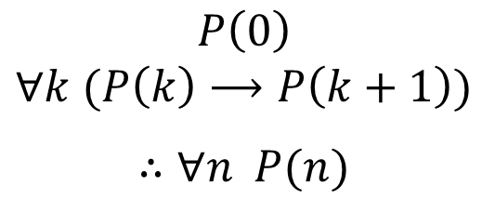
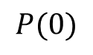
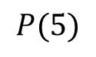
Recall: Induction Rule of Inference
Domain: Natural Numbers
$$P\left(0\right)$$
$$∀k (P\left(k\right)⟶P\left(k+1\right))$$
$$∴∀n P(n)$$
How do the givens prove P(5)?
P(0)→P(1) P(1)→P(2) P(2)→P(3) P(3)→P(4 ) P(4)→P(5)
$$P(0)$$
$$P(1)$$
$$P(2)$$
$$P(3)$$
$$P(4)$$
$$P(5)$$
Formal steps
Show P(0)
Assume P(k), Prove P(k+1), Conclude P(k)→ P(k+1)
Conclude ∀ k (P(k)→ P(k+1))
Conclude ∀ n P(n)

Slide 39
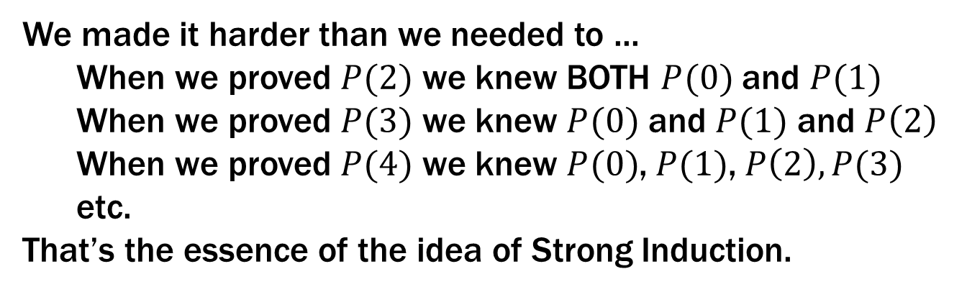
Recall: Induction Rule of Inference
Domain: Natural Numbers
$$P\left(0\right)$$
$$∀k (P\left(k\right)⟶P\left(k+1\right))$$
$$∴∀n P(n)$$
How do the givens prove P(5)?
P(0)→P(1) P(1)→P(2) P(2)→P(3) P(3)→P(4 ) P(4)→P(5)
$$P(0)$$
$$P(1)$$
$$P(2)$$
$$P(3)$$
$$P(4)$$
$$P(5)$$
We made it harder than we needed to ...
When we proved $P(2)$ we knew BOTH $P(0)$ and $P(1)$
When we proved $P(3)$ we knew $P(0)$ and $P(1)$ and $P\left(2\right)$
When we proved $P(4)$ we knew $P(0)$,$P(1)$,$P\left(2\right), P(3)$
etc.
That’s the essence of the idea of Strong Induction.
Formal steps
Show P(0)
Assume P(k), Prove P(k+1), Conclude P(k)→ P(k+1)
Conclude ∀ k (P(k)→ P(k+1))
Conclude ∀ n P(n)

Slide 40
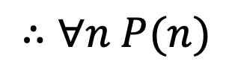
Strong Induction
$P\left(0\right) ∀k \left(∀j \left(0≤j≤k→P\left(j\right)\right)→P\left(k+1\right)\right)$
$∴∀n P(n)$

Slide 41
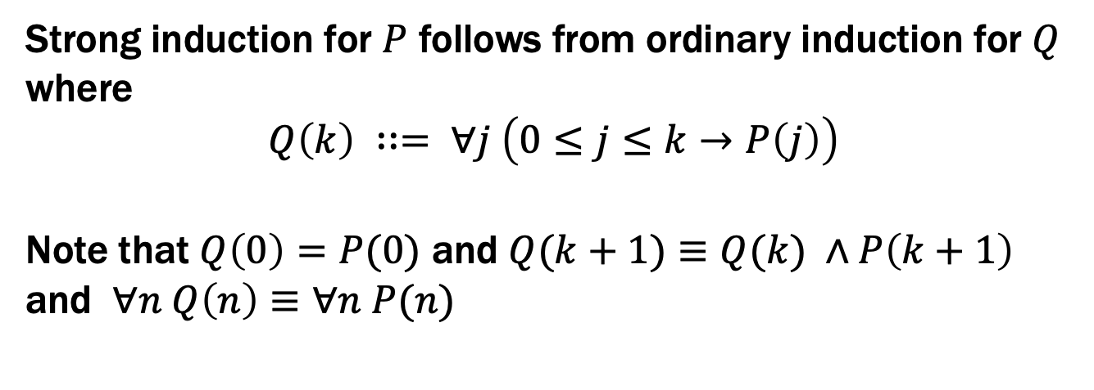
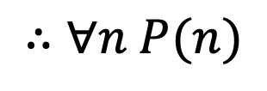
Strong Induction
$P\left(0\right) ∀k \left(∀j \left(0≤j≤k→P\left(j\right)\right)→P\left(k+1\right)\right)$
$∴∀n P(n)$
Strong induction for $P$ follows from ordinary induction for $Q$
where
$$Q\left(k\right) ∷= ∀j \left(0≤j≤k→P\left(j\right)\right)$$
Note that $Q\left(0\right)=P(0)$ and $Q(k+1)≡Q(k) ∧P\left(k+1\right)$
and $∀n Q\left(n\right)≡∀n P(n)$

Slide 42
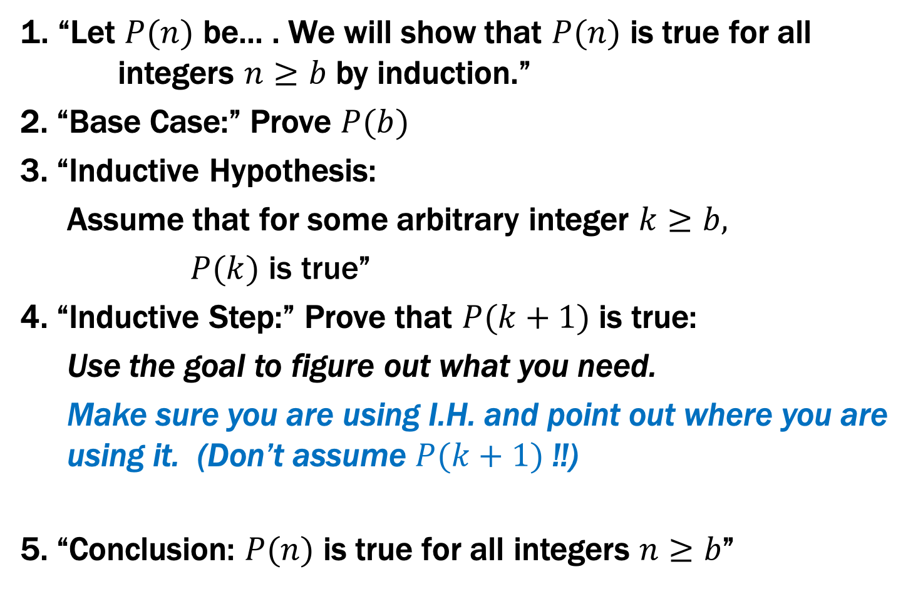
Inductive Proofs In 5 Easy Steps
1. “Let $P(n)$ be... . We will show that $P(n)$ is true for all integers $n≥b$ by induction.”
2. “Base Case:” Prove $P(b)$
3. “Inductive Hypothesis:
Assume that for some arbitrary integer $k≥b,$
$P(k) \text{is} \text{true}$”
4. “Inductive Step:” Prove that $P(k+1)$ is true:
Use the goal to figure out what you need.
Make sure you are using I.H. and point out where you are using it. (Don’t assume $P(k+1)$ !!)
5. “Conclusion: $P(n)$ is true for all integers $n≥b$”

Slide 43
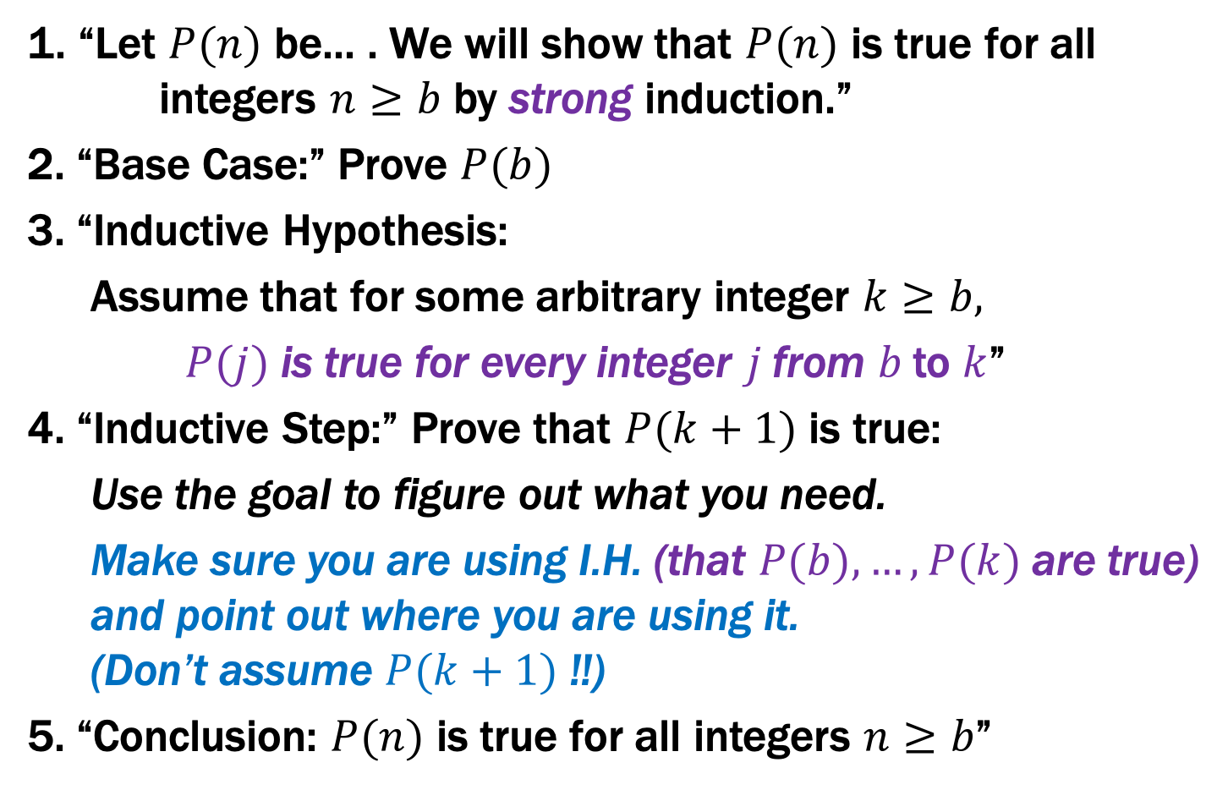
Strong Inductive Proofs In 5 Easy Steps
1. “Let $P(n)$ be... . We will show that $P(n)$ is true for all integers $n≥b$ by strong induction.”
2. “Base Case:” Prove $P(b)$
3. “Inductive Hypothesis:
Assume that for some arbitrary integer $k≥b,$
$P(j)$ is true for every integer $j$from $b$to $k$”
4. “Inductive Step:” Prove that $P(k+1)$ is true:
Use the goal to figure out what you need.
Make sure you are using I.H. (that $P(b),…,P(k)$ are true) and point out where you are using it. (Don’t assume $P(k+1)$ !!)
5. “Conclusion: $P(n)$ is true for all integers $n≥b$”

Slide 44
Recall: Fundamental Theorem of Arithmetic
Every integer > 1 has a unique prime factorization
48 = 2 • 2 • 2 • 2 • 3
591 = 3 • 197
45,523 = 45,523
321,950 = 2 • 5 • 5 • 47 • 137
1,234,567,890 = 2 • 3 • 3 • 5 • 3,607 • 3,803
We use strong induction to prove that a factorization into
primes exists, but not that it is unique.

Slide 45
Every integer $≥2$ is a product of (one or more) primes.
Examples to show its true
P(0)
P(k) → P(k+1)

Slide 46
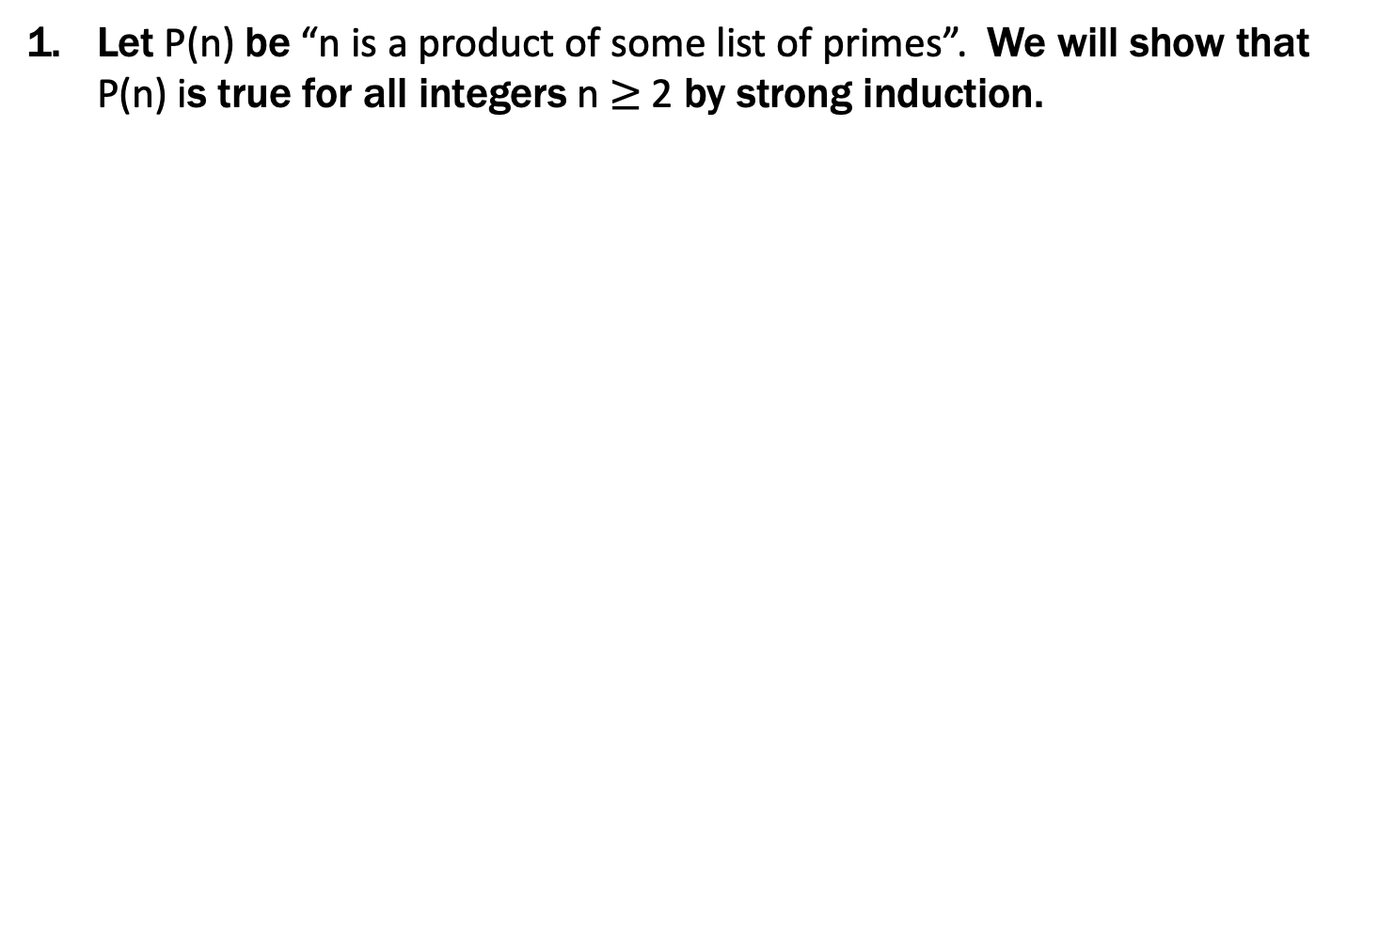
Every integer $≥2$ is a product of (one or more) primes.
Let P(n) be “n is a product of some list of primes”. We will show that P(n) is true for all integers n $≥$2 by strong induction.
Base Case (n=2): 2 is prime, so it is a product of primes. Therefore P(2) is true.
Inductive : Suppose that for some arbitrary integer k ≥ 2, P(j) is true for every integer j between 2 and k
Inductive Step:
Goal: Show P(k+1); i.e. k+1 is a product of primes
Case: k+1 is prime: Then by definition k+1 is a product of primes
Case: k+1 is composite: Then k+1=ab for some integers a and b where 2 ≤ a, b ≤ k. By our IH, P(a) and P(b) are true so we have a = p₁p₂ $⋯$p_{m} and b = q₁q₂ $⋯$ for some primes p₁,p₂,..., p_{m}, q₁,q₂,..., q_{n}.
Thus, k+1 = ab = p₁p₂ $⋯$ p_{m}q₁q₂ $⋯$q_{n} which is a product of primes. Since k ≥ 1, one of these cases must happen and so P(k+1) is true:
5. Thus P(n) is true for all integers n $≥$2, by induction.
Examples to show its true
P(0)
P(k) → P(k+1)

Slide 47
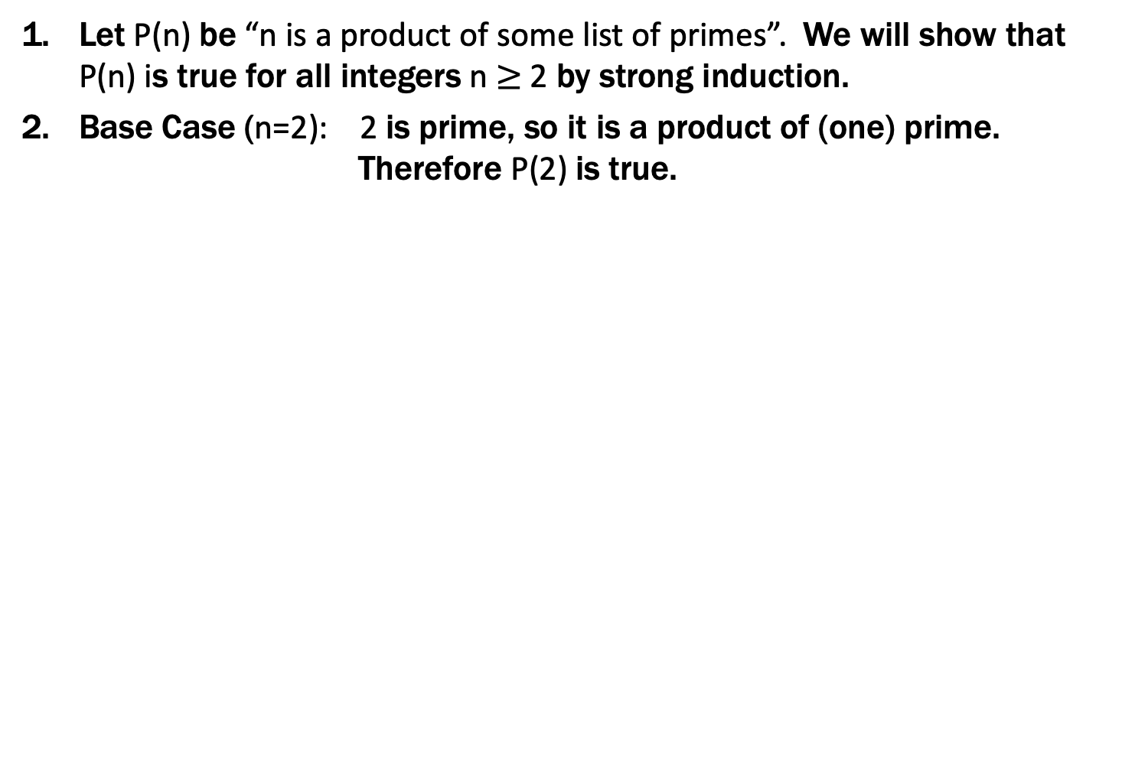
Every integer $≥2$ is a product of (one or more) primes.
Let P(n) be “n is a product of some list of primes”. We will show that P(n) is true for all integers n $≥$2 by strong induction.
Base Case (n=2): 2 is prime, so it is a product of (one) prime. Therefore P(2) is true.
Inductive : Suppose that for some arbitrary integer k ≥ 2, P(j) is true for every integer j between 2 and k
Inductive Step:
Goal: Show P(k+1); i.e. k+1 is a product of primes
Case: k+1 is prime: Then by definition k+1 is a product of primes
Case: k+1 is composite: Then k+1=ab for some integers a and b where 2 ≤ a, b ≤ k. By our IH, P(a) and P(b) are true so we have a = p₁p₂ $⋯$p_{m} and b = q₁q₂ $⋯$ for some primes p₁,p₂,..., p_{m}, q₁,q₂,..., q_{n}.
Thus, k+1 = ab = p₁p₂ $⋯$ p_{m}q₁q₂ $⋯$q_{n} which is a product of primes. Since k ≥ 1, one of these cases must happen and so P(k+1) is true:
5. Thus P(n) is true for all integers n $≥$2, by induction.
Examples to show its true
P(0)
P(k) → P(k+1)

Slide 48
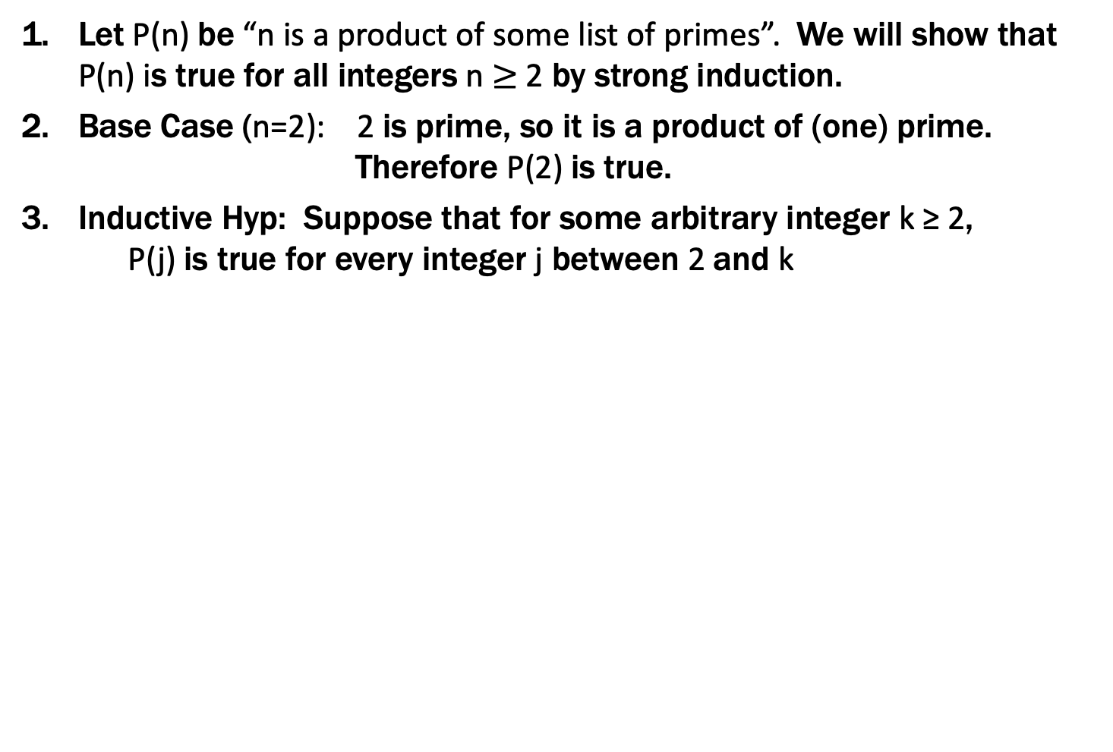
Every integer $≥2$ is a product of (one or more) primes.
Let P(n) be “n is a product of some list of primes”. We will show that P(n) is true for all integers n $≥$2 by strong induction.
Base Case (n=2): 2 is prime, so it is a product of (one) prime. Therefore P(2) is true.
Inductive Hyp: Suppose that for some arbitrary integer k ≥ 2, P(j) is true for every integer j between 2 and k
Inductive Step:
Goal: Show P(k+1); i.e. k+1 is a product of primes
Case: k+1 is prime: Then by definition k+1 is a product of primes
Case: k+1 is composite: Then k+1=ab for some integers a and b where 2 ≤ a, b ≤ k. By our IH, P(a) and P(b) are true so we have a = p₁p₂ $⋯$p_{m} and b = q₁q₂ $⋯$q_{n} for some primes p₁,p₂,..., p_{m}, q₁,q₂,..., q_{n}.
Thus, k+1 = ab = p₁p₂ $⋯$ p_{m}q₁q₂ $⋯$q_{n} which is a product of primes. Since k ≥ 1, one of these cases must happen and so P(k+1) is true:
5. Thus P(n) is true for all integers n $≥$2, by induction.
Examples to show its true
P(0)
P(k) → P(k+1)

Slide 49
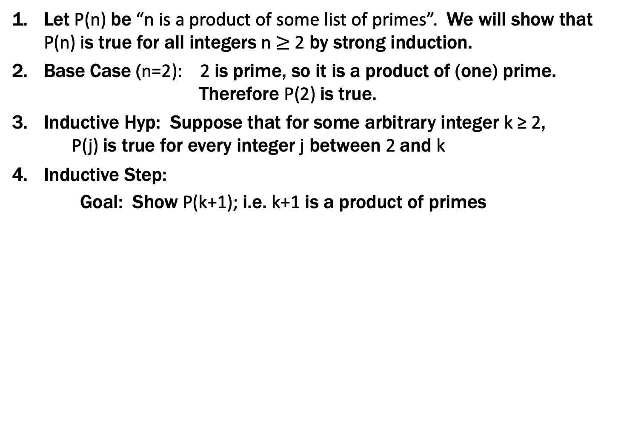
Every integer $≥2$ is a product of (one or more) primes.
Let P(n) be “n is a product of some list of primes”. We will show that P(n) is true for all integers n $≥$2 by strong induction.
Base Case (n=2): 2 is prime, so it is a product of (one) prime. Therefore P(2) is true.
Inductive Hyp: Suppose that for some arbitrary integer k ≥ 2, P(j) is true for every integer j between 2 and k
Inductive Step:
Goal: Show P(k+1); i.e. k+1 is a product of primes
Case: k+1 is prime: Then by definition k+1 is a product of primes
Case: k+1 is composite: Then k+1=ab for some integers a and b where 2 ≤ a, b ≤ k. By our IH, P(a) and P(b) are true so we have a = p₁p₂ $⋯$p_{m} and b = q₁q₂ $⋯$q_{n} for some primes p₁,p₂,..., p_{m}, q₁,q₂,..., q_{n}.
Thus, k+1 = ab = p₁p₂ $⋯$ p_{m}q₁q₂ $⋯$q_{n} which is a product of primes. Since k ≥ 1, one of these cases must happen and so P(k+1) is true:
5. Thus P(n) is true for all integers n $≥$2, by induction.
Examples to show its true
P(0)
P(k) → P(k+1)

Slide 50
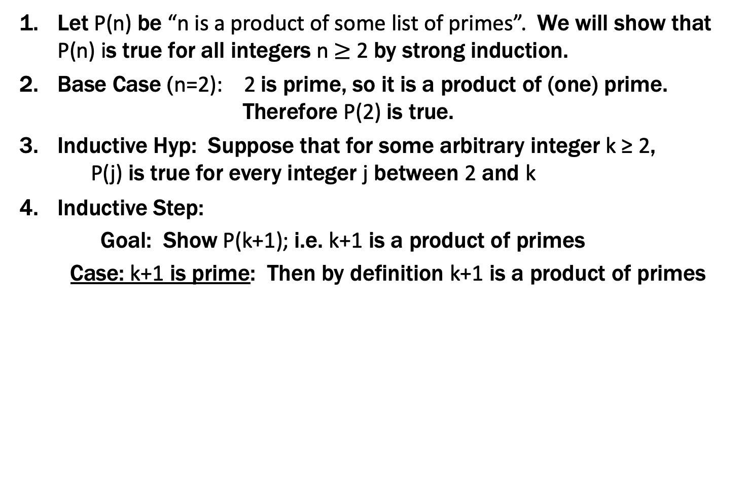
Every integer $≥2$ is a product of (one or more) primes.
Let P(n) be “n is a product of some list of primes”. We will show that P(n) is true for all integers n $≥$2 by strong induction.
Base Case (n=2): 2 is prime, so it is a product of (one) prime. Therefore P(2) is true.
Inductive Hyp: Suppose that for some arbitrary integer k ≥ 2, P(j) is true for every integer j between 2 and k
Inductive Step:
Goal: Show P(k+1); i.e. k+1 is a product of primes
Case: k+1 is prime: Then by definition k+1 is a product of primes
Case: k+1 is composite: Then k+1=ab for some integers a and b where 2 ≤ a, b ≤ k. By our IH, P(a) and P(b) are true so we have a = p₁p₂ $⋯$p_{m} and b = q₁q₂ $⋯$ for some primes p₁,p₂,..., p_{m}, q₁,q₂,..., q_{n}.
Thus, k+1 = ab = p₁p₂ $⋯$ p_{m}q₁q₂ $⋯$q_{n} which is a product of primes. Since k ≥ 1, one of these cases must happen and so P(k+1) is true:
5. Thus P(n) is true for all integers n $≥$2, by induction.
Examples to show its true
P(0)
P(k) → P(k+1)

Slide 51
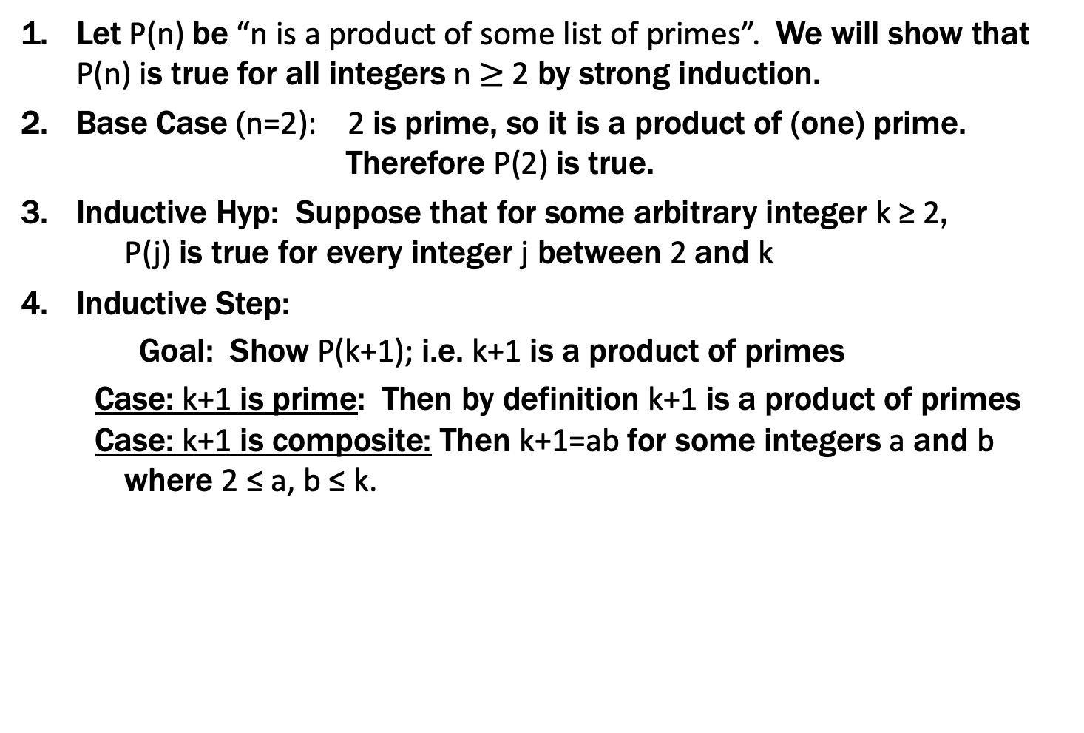
Every integer $≥2$ is a product of (one or more) primes.
Let P(n) be “n is a product of some list of primes”. We will show that P(n) is true for all integers n $≥$2 by strong induction.
Base Case (n=2): 2 is prime, so it is a product of (one) prime. Therefore P(2) is true.
Inductive Hyp: Suppose that for some arbitrary integer k ≥ 2, P(j) is true for every integer j between 2 and k
Inductive Step:
Goal: Show P(k+1); i.e. k+1 is a product of primes
Case: k+1 is prime: Then by definition k+1 is a product of primes
Case: k+1 is composite: Then k+1=ab for some integers a and b where 2 ≤ a, b ≤ k. By our IH, P(a) and P(b) are true so we have a = p₁p₂ $⋯$p_{m} and b = q₁q₂ $⋯$q_{n} for some primes p₁,p₂,..., p_{m}, q₁,q₂,..., q_{n}.
Thus, k+1 = ab = p₁p₂ $⋯$ p_{m}q₁q₂ $⋯$q_{n} which is a product of primes. Since k ≥ 1, one of these cases must happen and so P(k+1) is true:
5. Thus P(n) is true for all integers n $≥$2, by induction.
Examples to show its true
P(0)
P(k) → P(k+1)

Slide 52
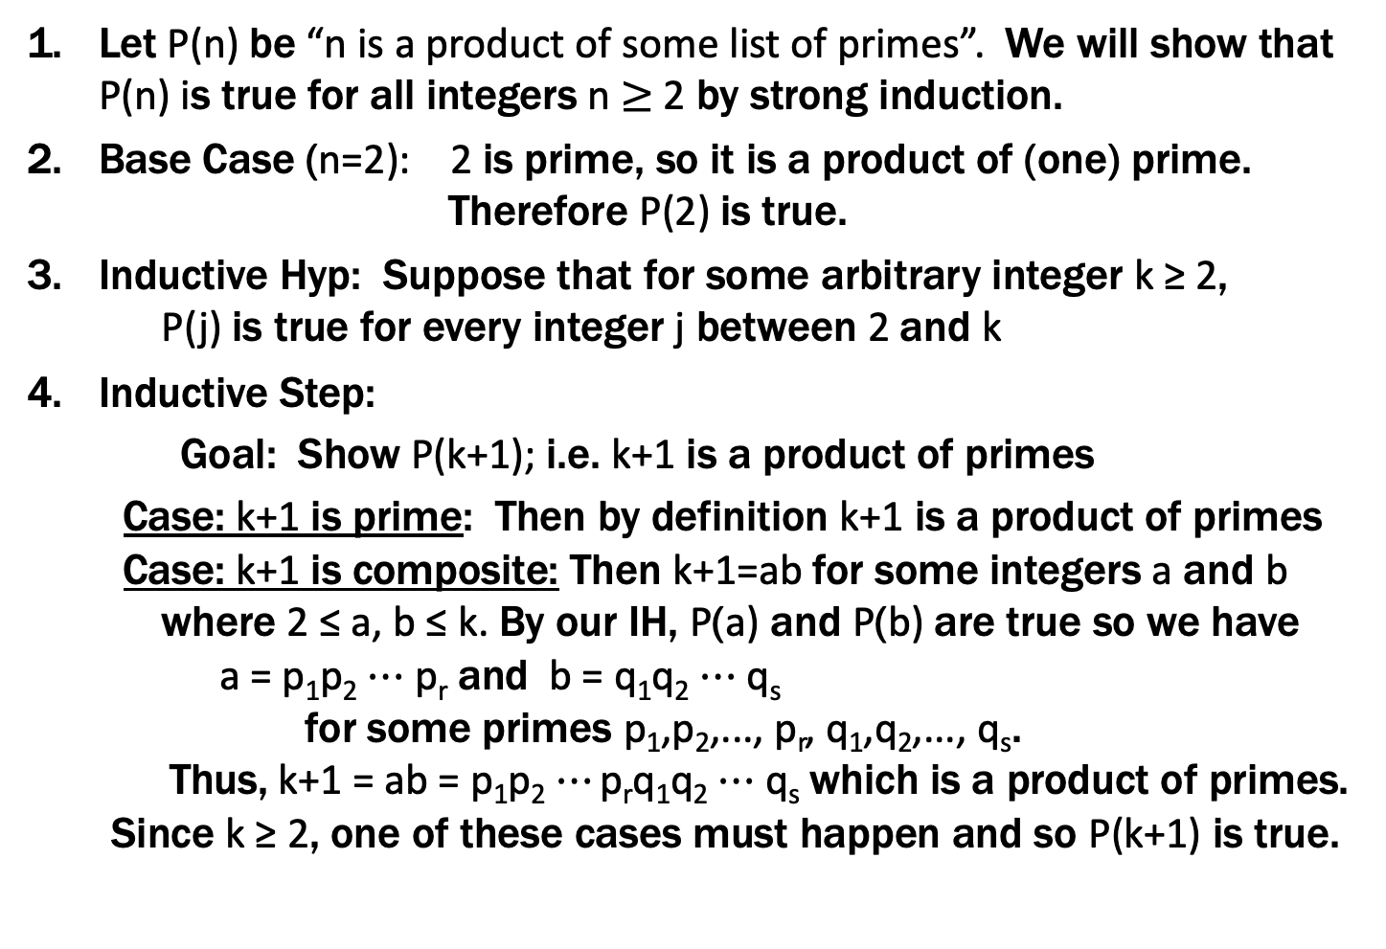
Every integer $≥2$ is a product of (one or more) primes.
Let P(n) be “n is a product of some list of primes”. We will show that P(n) is true for all integers n $≥$2 by strong induction.
Base Case (n=2): 2 is prime, so it is a product of (one) prime. Therefore P(2) is true.
Inductive Hyp: Suppose that for some arbitrary integer k ≥ 2, P(j) is true for every integer j between 2 and k
Inductive Step:
Goal: Show P(k+1); i.e. k+1 is a product of primes
Case: k+1 is prime: Then by definition k+1 is a product of primes
Case: k+1 is composite: Then k+1=ab for some integers a and b where 2 ≤ a, b ≤ k. By our IH, P(a) and P(b) are true so we have a = p₁p₂ $⋯$p_{r} and b = q₁q₂ $⋯$q_{s} for some primes p₁,p₂,..., p_{r}, q₁,q₂,..., q_{s}.
Thus, k+1 = ab = p₁p₂ $⋯$ p_{r}q₁q₂ $⋯$q_{s} which is a product of primes. Since k ≥ 2, one of these cases must happen and so P(k+1) is true.
5. Thus P(n) is true for all integers n $≥$2, by induction.
Examples to show its true
P(0)
P(k) → P(k+1)

Slide 53
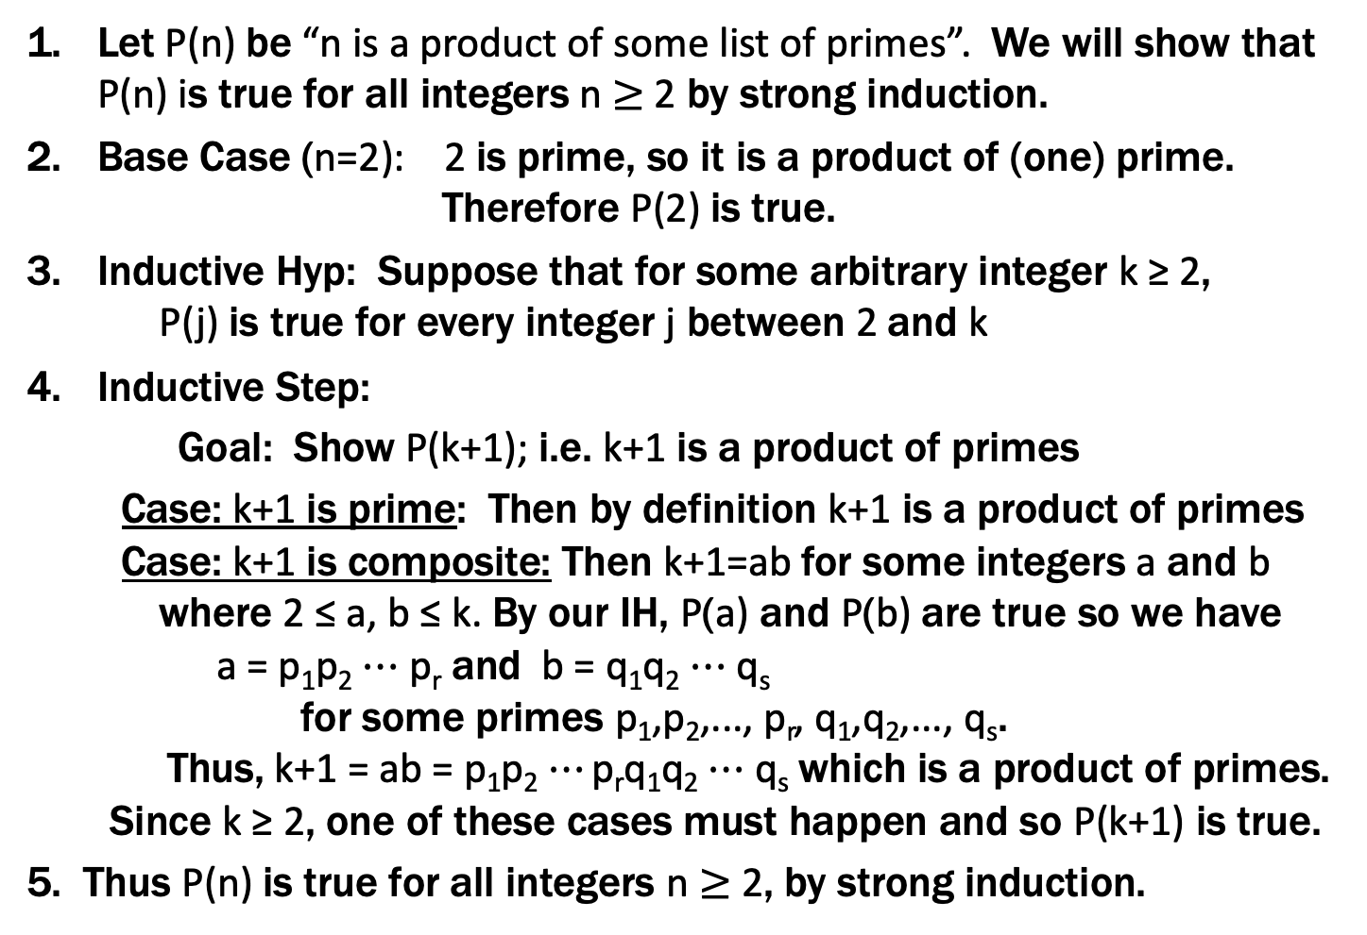
Every integer $≥2$ is a product of (one or more) primes.
Let P(n) be “n is a product of some list of primes”. We will show that P(n) is true for all integers n $≥$2 by strong induction.
Base Case (n=2): 2 is prime, so it is a product of (one) prime. Therefore P(2) is true.
Inductive Hyp: Suppose that for some arbitrary integer k ≥ 2, P(j) is true for every integer j between 2 and k
Inductive Step:
Goal: Show P(k+1); i.e. k+1 is a product of primes
Case: k+1 is prime: Then by definition k+1 is a product of primes
Case: k+1 is composite: Then k+1=ab for some integers a and b where 2 ≤ a, b ≤ k. By our IH, P(a) and P(b) are true so we have a = p₁p₂ $⋯$p_{r} and b = q₁q₂ $⋯$q_{s} for some primes p₁,p₂,..., p_{r}, q₁,q₂,..., q_{s}.
Thus, k+1 = ab = p₁p₂ $⋯$ p_{r}q₁q₂ $⋯$q_{s} which is a product of primes. Since k ≥ 2, one of these cases must happen and so P(k+1) is true.
5. Thus P(n) is true for all integers n $≥$2, by strong induction.
Examples to show its true
P(0)
P(k) → P(k+1)

Slide 54
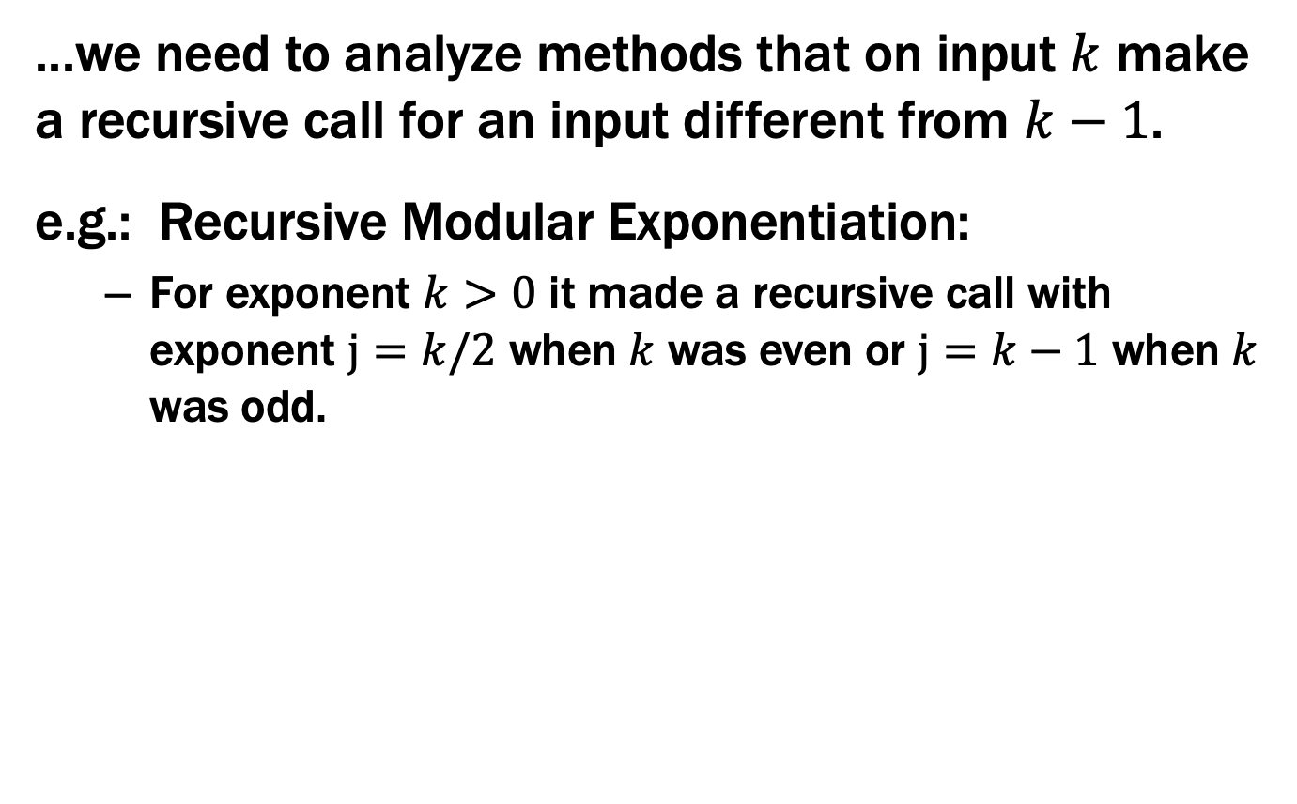
Strong Induction is particularly useful when...
...we need to analyze methods that on input $k$ make a recursive call for an input different from $k−1$.
e.g.: Recursive Modular Exponentiation:
For exponent $k>0$ it made a recursive call with exponent $j=k/2$ when $k$ was even or $j=k−1$ when $k$ was odd.

Slide 55
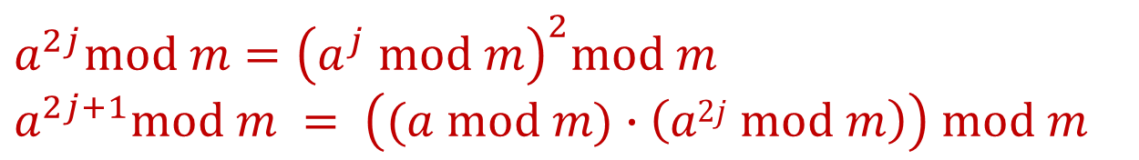
Fast Exponentiation
public static int FastModExp(int a, int k, int modulus) {
if (k == 0) {
return 1;
} else if ((k % 2) == 0) {
long temp = FastModExp(a,k/2,modulus);
return (temp * temp) % modulus;
} else {
long temp = FastModExp(a,k-1,modulus);
return (a * temp) % modulus;
}
}
$$a^{2j}mod m={\left(a^{j} mod m\right)}^{2}mod m$$
$$a^{2j+1}mod m = \left((a mod m)∙\left(a2j mod m\right)\right) mod m$$

Slide 56
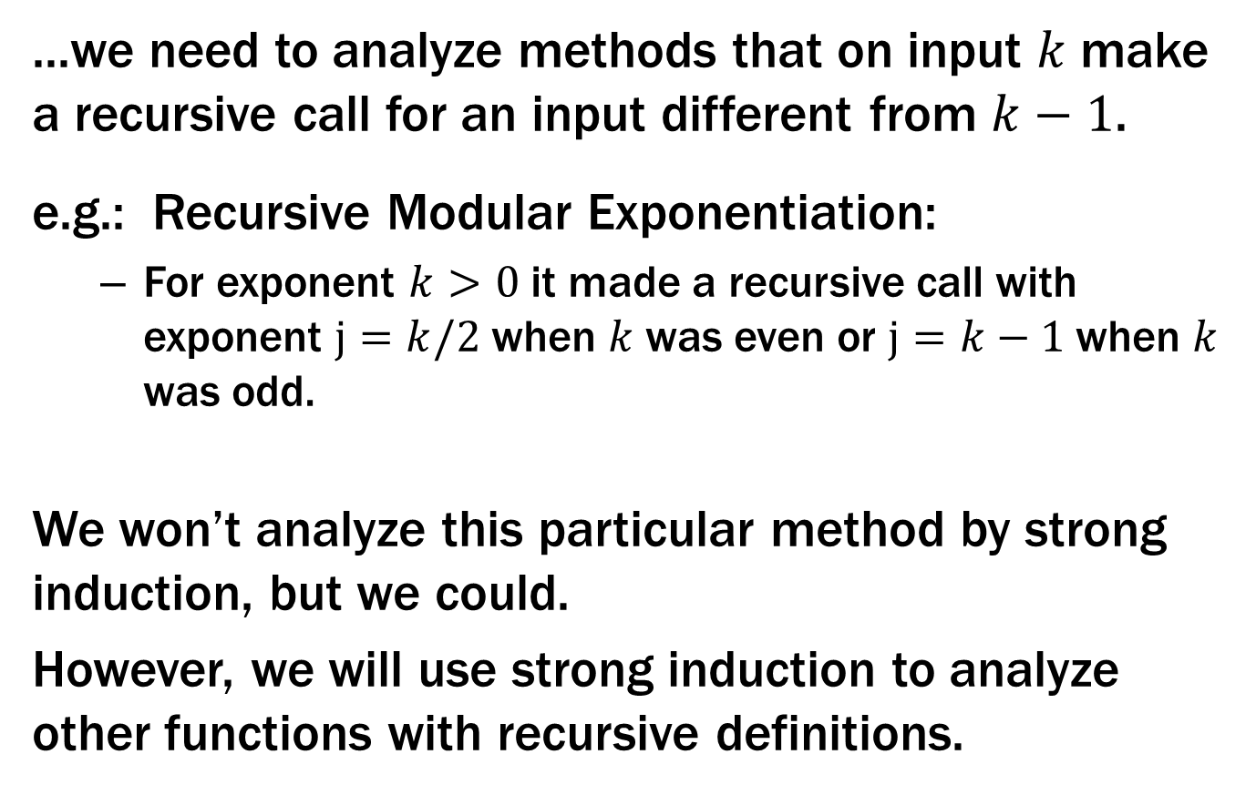
Strong Induction is particularly useful when...
...we need to analyze methods that on input $k$ make a recursive call for an input different from $k−1$.
e.g.: Recursive Modular Exponentiation:
For exponent $k>0$ it made a recursive call with exponent $j=k/2$ when $k$ was even or $j=k−1$ when $k$ was odd.
We won’t analyze this particular method by strong induction, but we could.
However, we will use strong induction to analyze other functions with recursive definitions.

